Slide 1

Chapter 2
Mathematical Background

Slide 2
Core Topics
(i) Concepts from Calculus (2.2)
(ii) Vectors (2.3)
(iii) Matrices and Linear Algebra (2.4)
(iv) Ordinary Differential Equations (ODEs) (2.5)
(v) Functions of two or more independent variables and partial differentation (2.6)
(vi) Taylor Series (2.7)
(vii) Inner Product and Orthogonality (2.8)

Slide 3
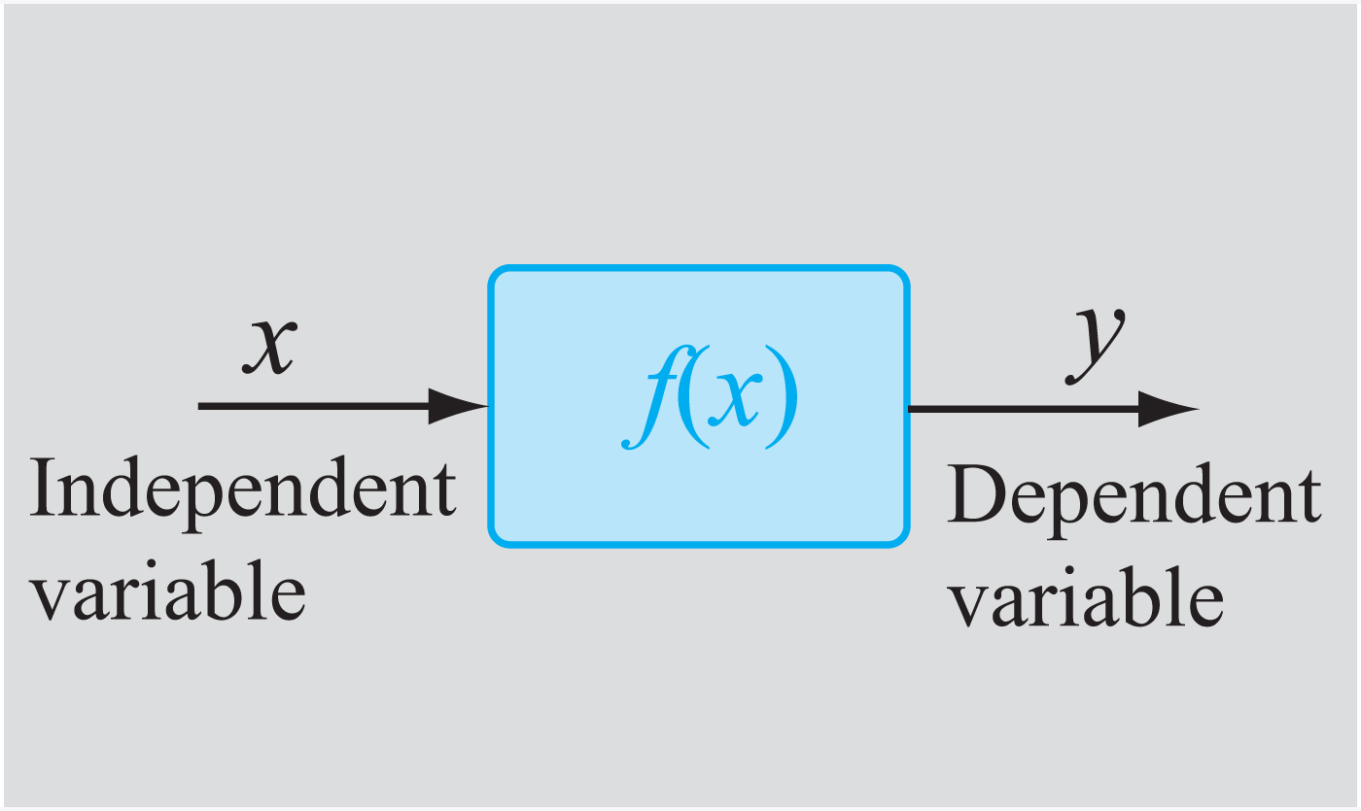
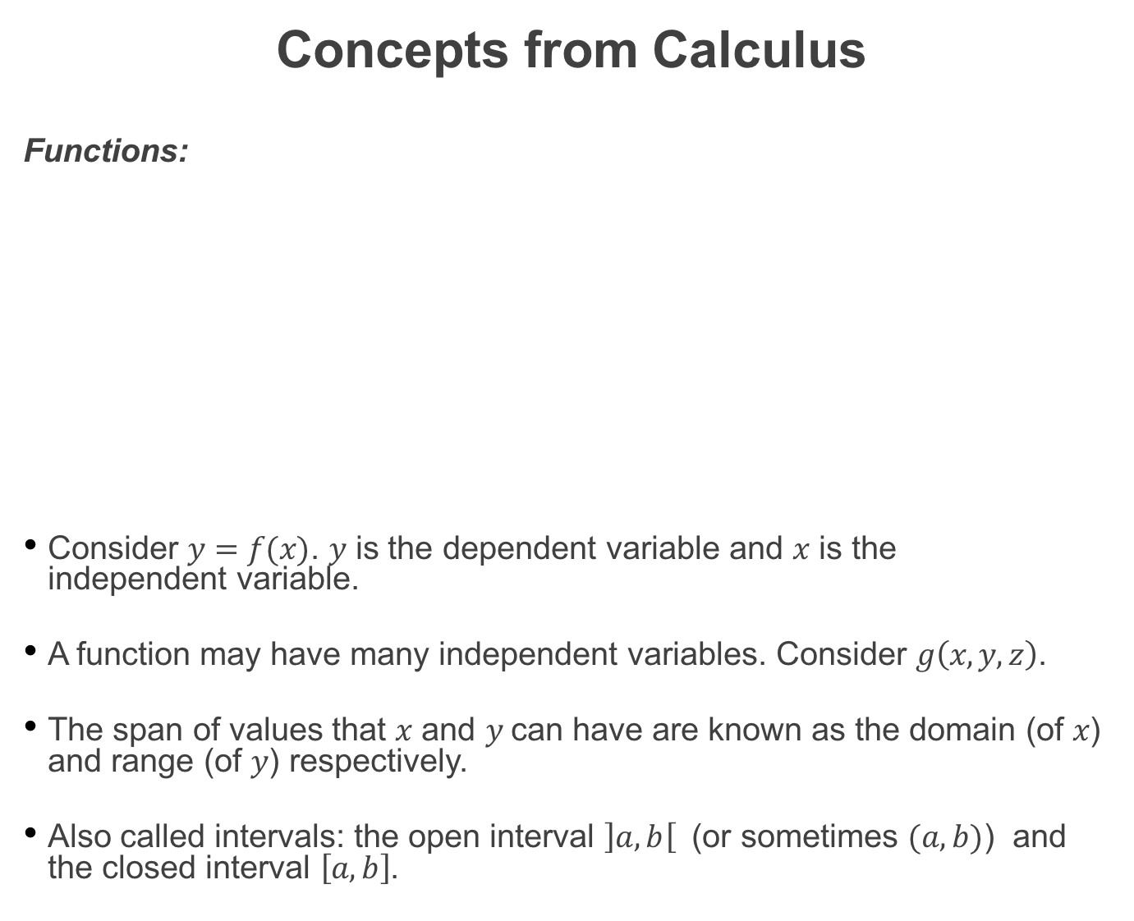
Concepts from Calculus
Functions:
Consider $y=f(x)$. $y$ is the dependent variable and $x$ is the independent variable.
A function may have many independent variables. Consider $g\left(x,y,z\right)$.
The span of values that $x$ and $y$can have are known as the domain (of $x$) and range (of $y$) respectively.
Also called intervals: the open interval $\left]a,b\right[$ (or sometimes $(a,b)$) and the closed interval $\left[a,b\right]$.

Slide 4
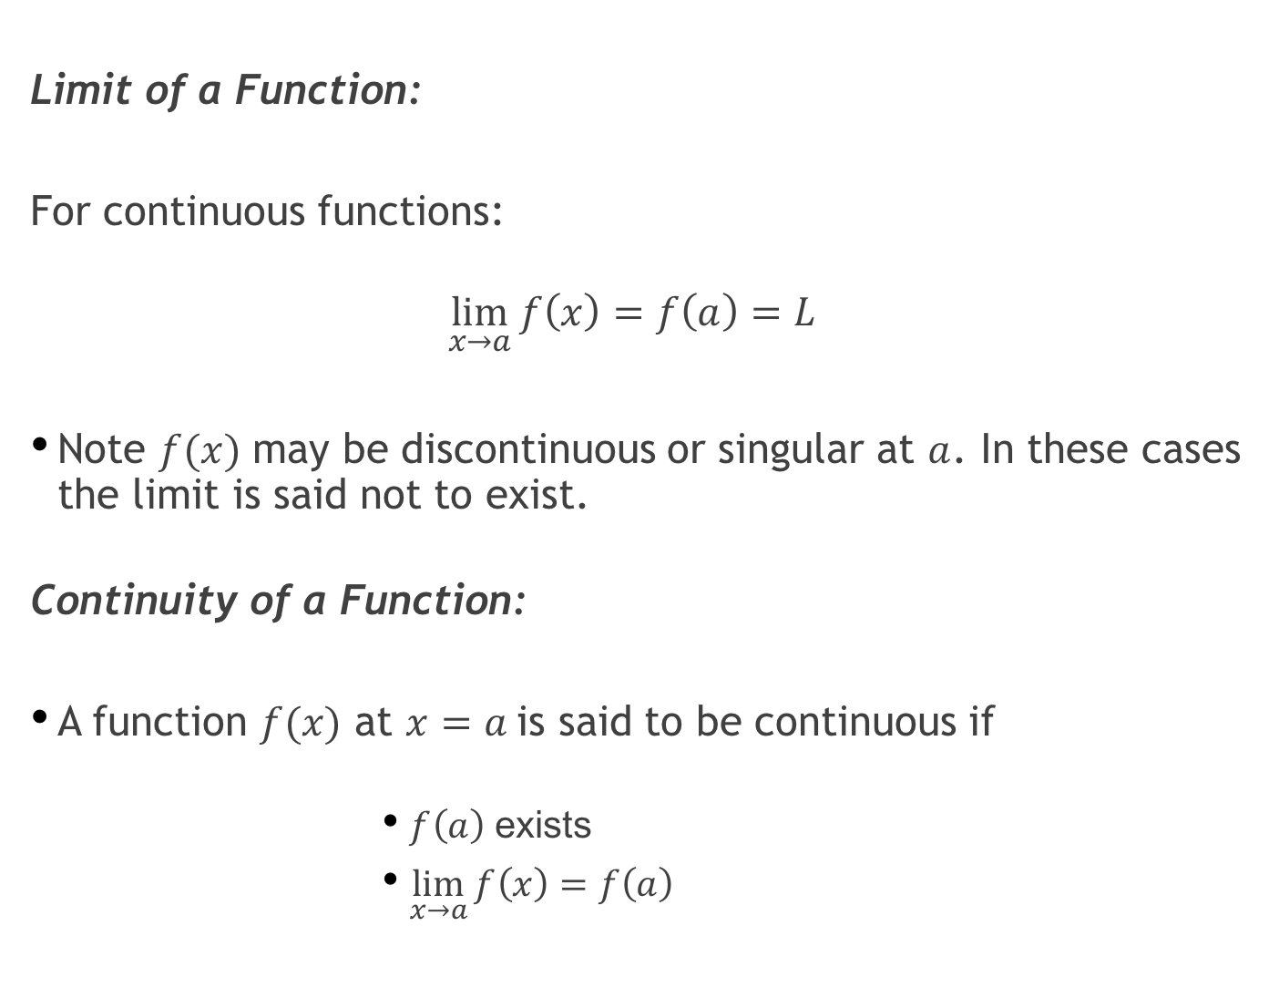
Limit of a Function:
For continuous functions:
$$\lim_{x→a}{f\left(x\right)=f\left(a\right)=L}$$
Note $f(x)$ may be discontinuous or singular at $a$. In these cases the limit is said not to exist.
Continuity of a Function:
A function $f(x)$ at $x=a$is said to be continuous if
$f\left(a\right)$ exists
$\lim_{x→a}{f\left(x\right)=f\left(a\right)}$

Slide 5
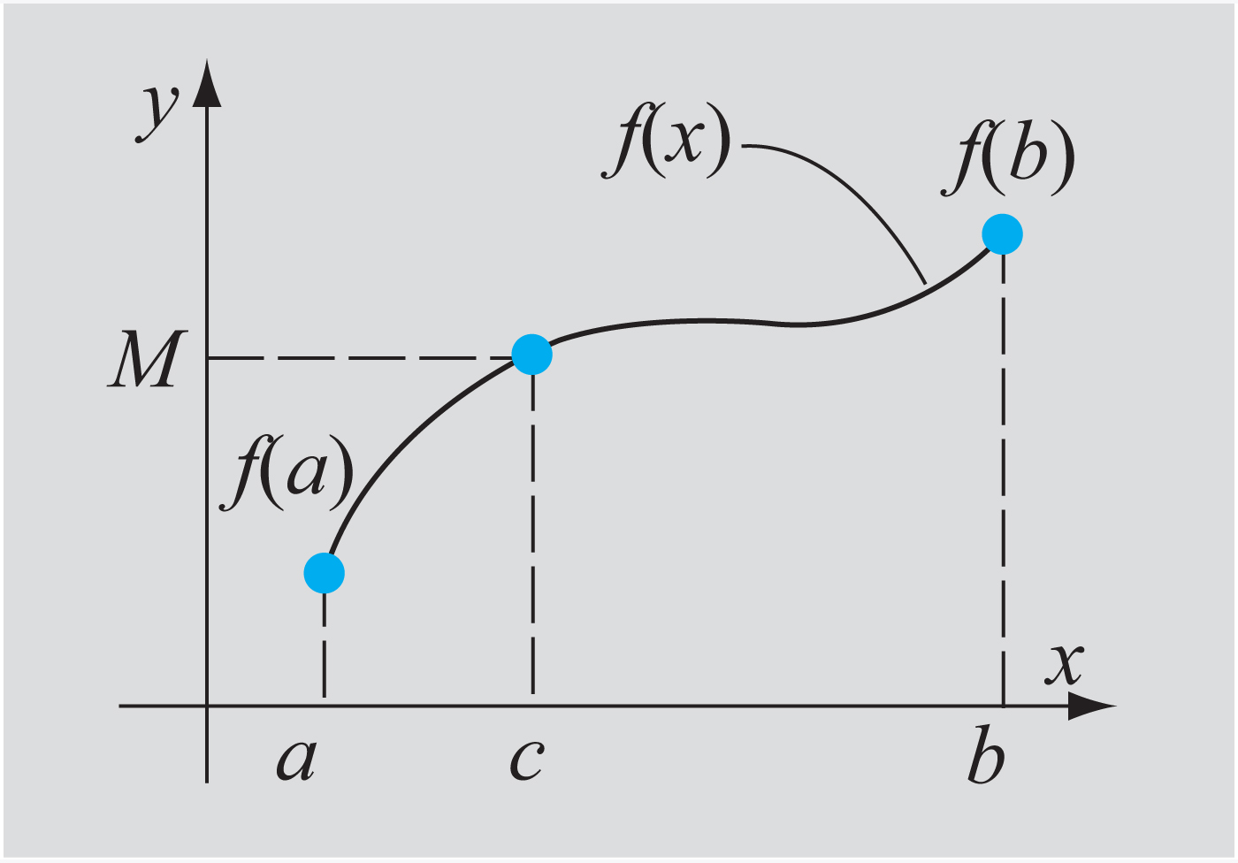
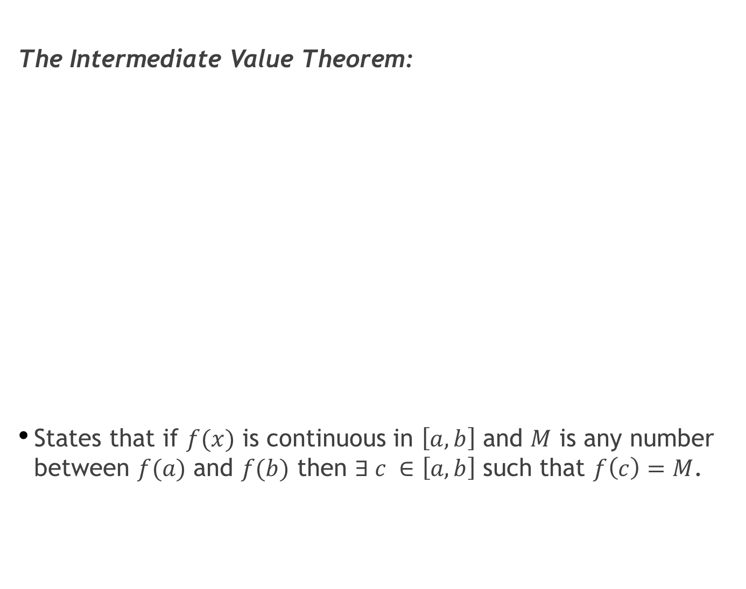
The Intermediate Value Theorem:
States that if $f(x)$ is continuous in $\left[a,b\right]$ and $M$ is any number between $f(a)$ and $f(b)$ then $∃ c ∈\left[a,b\right]$ such that $f\left(c\right)=M$.

Slide 6
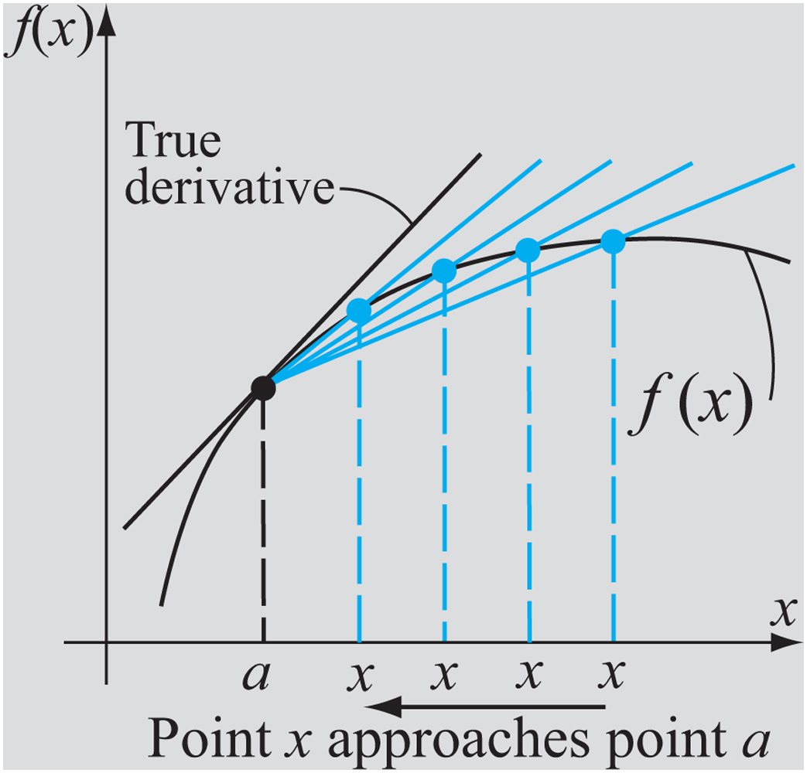
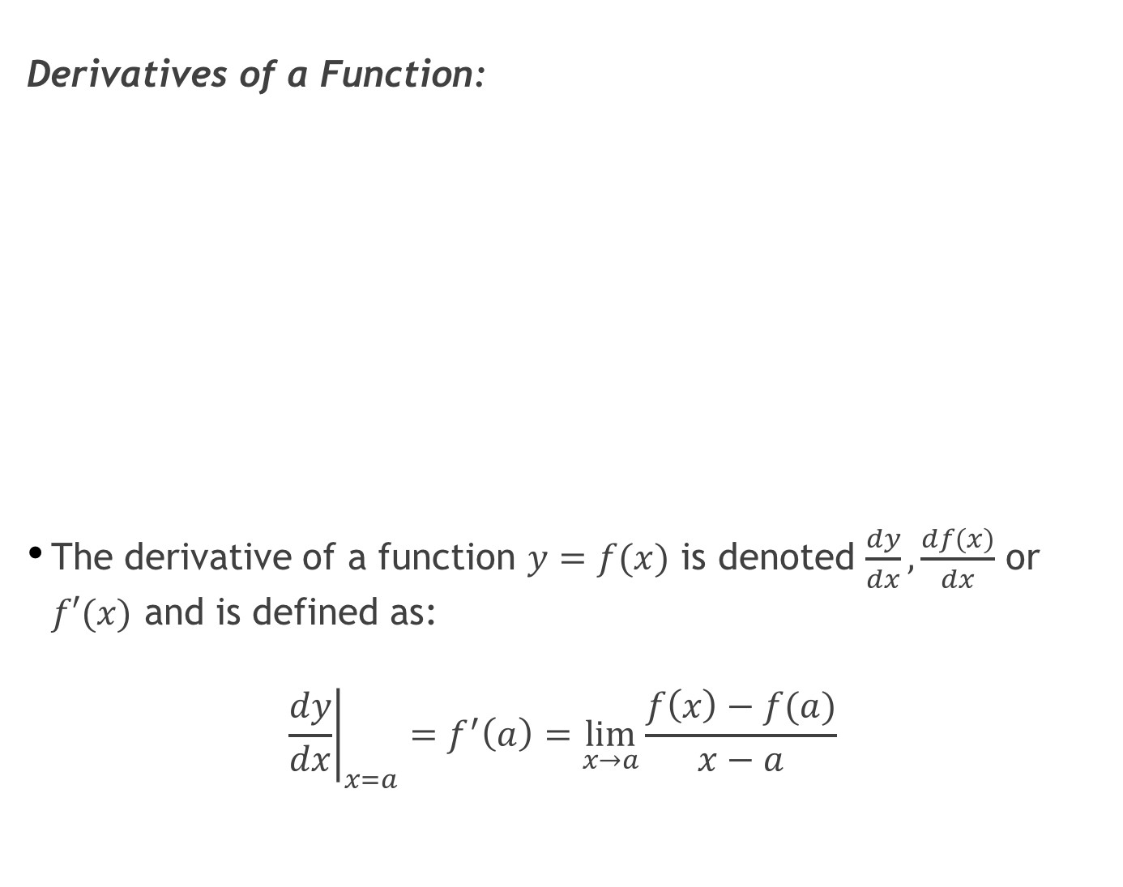
Derivatives of a Function:
The derivative of a function $y=f(x)$ is denoted $\frac{dy}{dx}, \frac{df(x)}{dx}$ or $f′(x)$ and is defined as:
$${\left.\frac{dy}{dx}\right|}_{x=a}=f^{′}\left(a\right)=\lim_{x→a}{\frac{f\left(x\right)−f(a)}{x−a}}$$

Slide 7
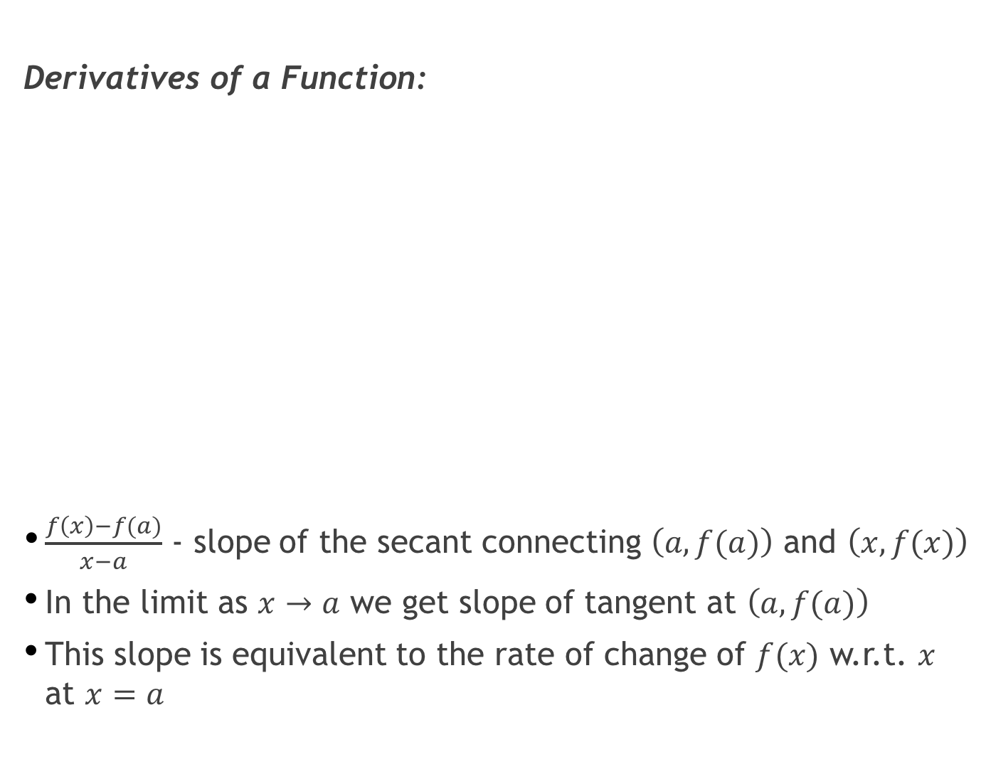
Derivatives of a Function:
$\frac{f\left(x\right)−f(a)}{x−a}$ - slope of the secant connecting $\left(a,f(a)\right)$ and $\left(x,f(x)\right)$
In the limit as $x→a$ we get slope of tangent at $\left(a,f(a)\right)$
This slope is equivalent to the rate of change of $f(x)$ w.r.t. $x$ at $x=a$

Slide 8
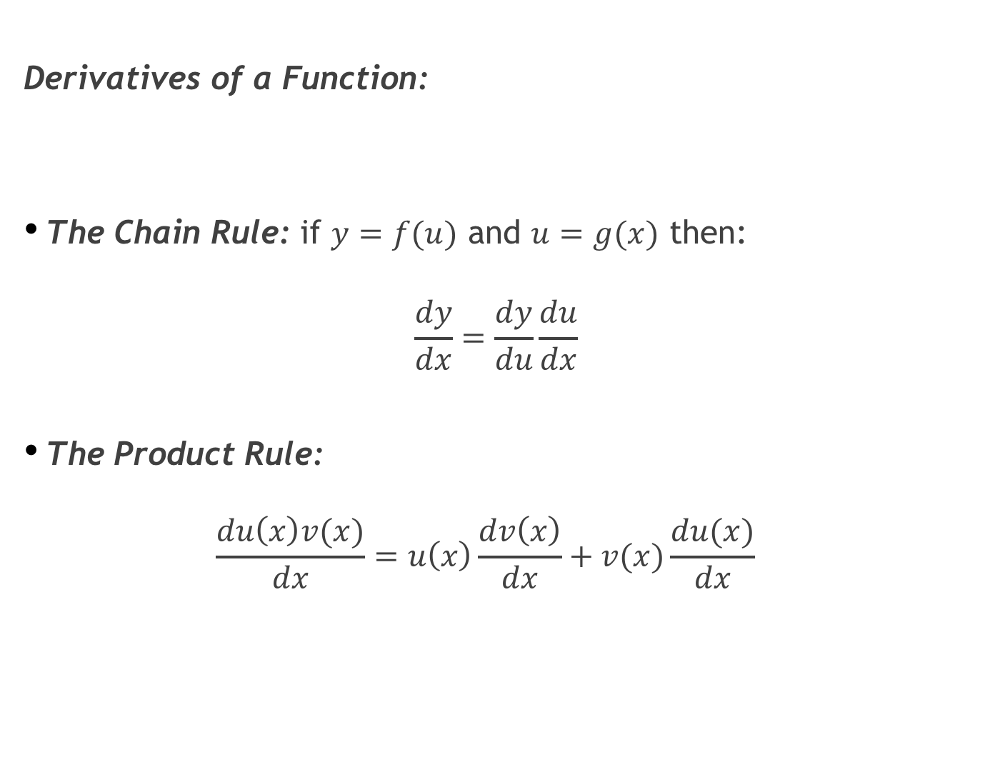
Derivatives of a Function:
The Chain Rule: if $y=f(u)$ and $u=g(x)$ then:
$$\frac{dy}{dx}=\frac{dy}{du}\frac{du}{dx}$$
The Product Rule: $\frac{du\left(x\right)v(x)}{dx}=u\left(x\right)\frac{dv\left(x\right)}{dx}+v(x)\frac{du(x)}{dx}$

Slide 9
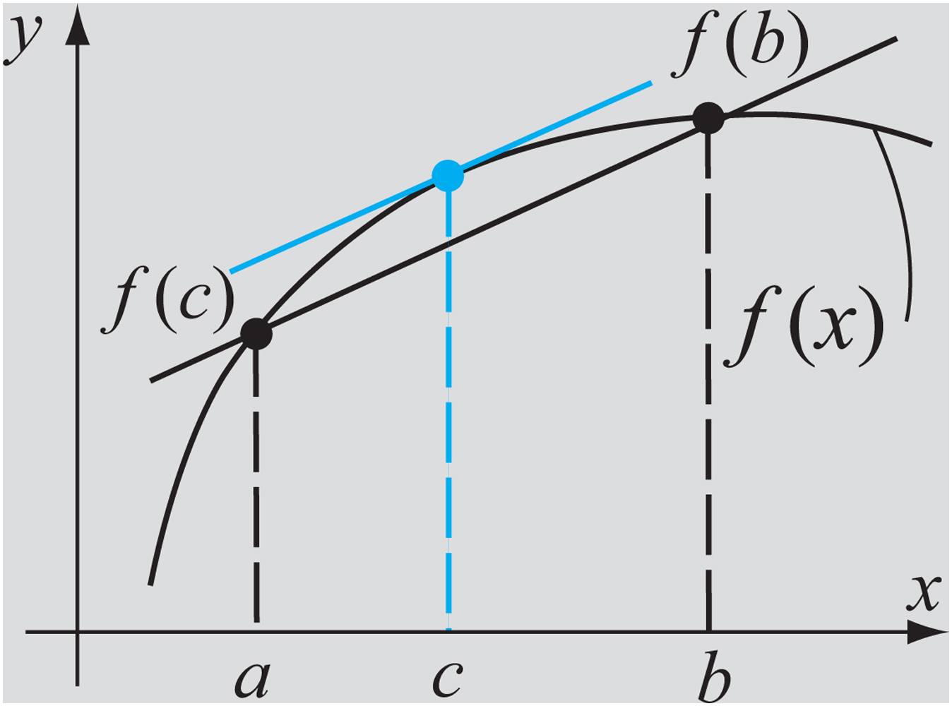
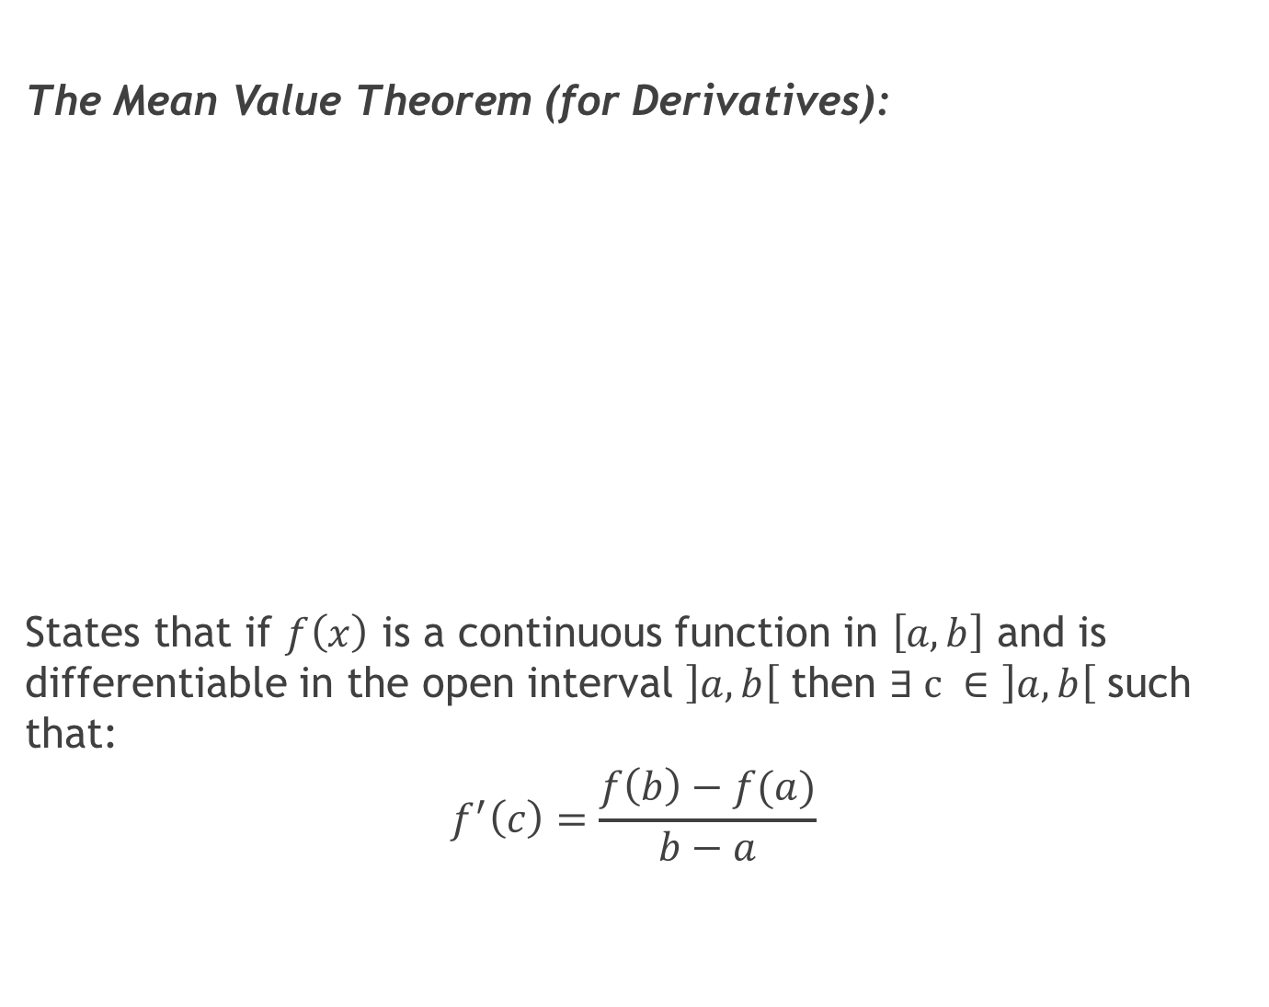
The Mean Value Theorem (for Derivatives):
States that if $f\left(x\right)$ is a continuous function in $\left[a,b\right]$ and is differentiable in the open interval $\left]a,b\right[$ then $∃ c ∈\left]a,b\right[$ such that:
$$f^{′}\left(c\right)=\frac{f\left(b\right)−f(a)}{b−a}$$

Slide 10
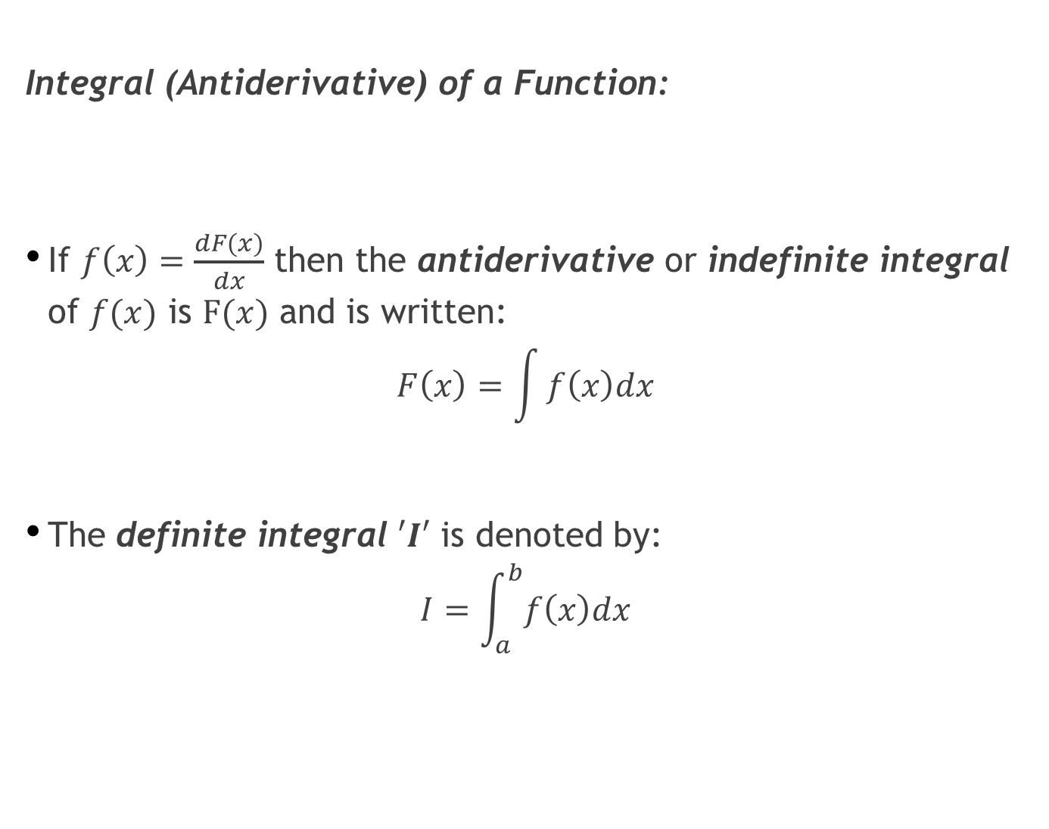
Integral (Antiderivative) of a Function:
If $f\left(x\right)=\frac{dF(x)}{dx}$ then the antiderivative or indefinite integral of $f(x)$ is $F(x)$ and is written:
$$F\left(x\right)=\int{f\left(x\right)dx}$$
The definite integral $′I′$ is denoted by:
$$I=\int_{a}^{b}{f\left(x\right)dx}$$

Slide 11
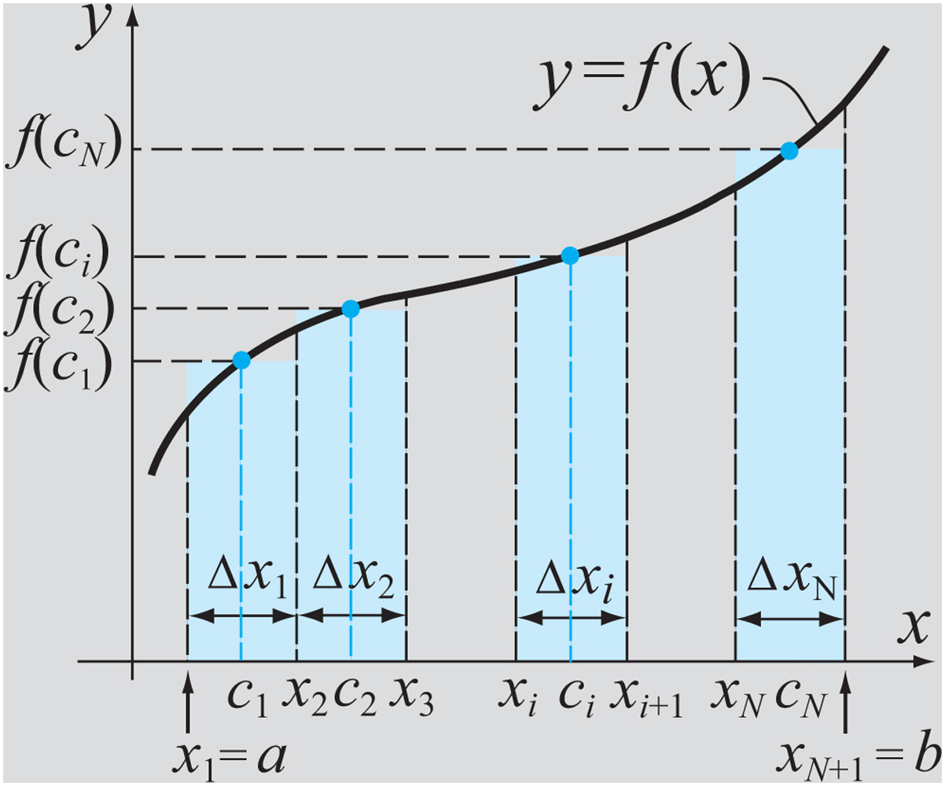
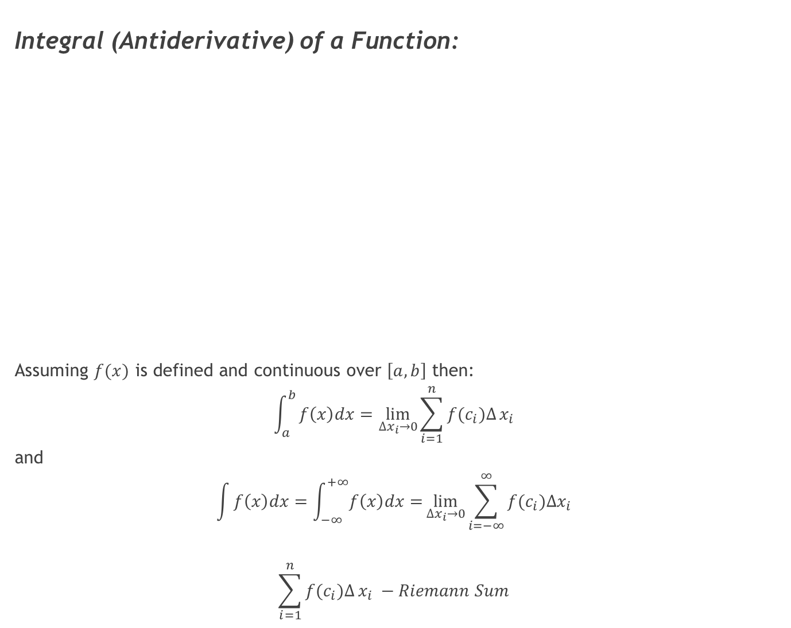
Integral (Antiderivative) of a Function:
Assuming $f(x)$ is defined and continuous over $\left[a,b\right]$ then:
$$\int_{a}^{b}{f\left(x\right)dx=\lim_{∆x_{i}→0}{\sum_{i=1}^{n}{f(c_{i})∆}x_{i}}}$$
and
$$\int{f\left(x\right)dx=\int_{−∞}^{+∞}{f\left(x\right)dx=}}\lim_{∆x_{i}→0}{\sum_{i=−∞}^{∞}{f(c_{i})∆x_{i}}}$$
$$\sum_{i=1}^{n}{f(c_{i})∆}x_{i} −Riemann Sum$$

Slide 12
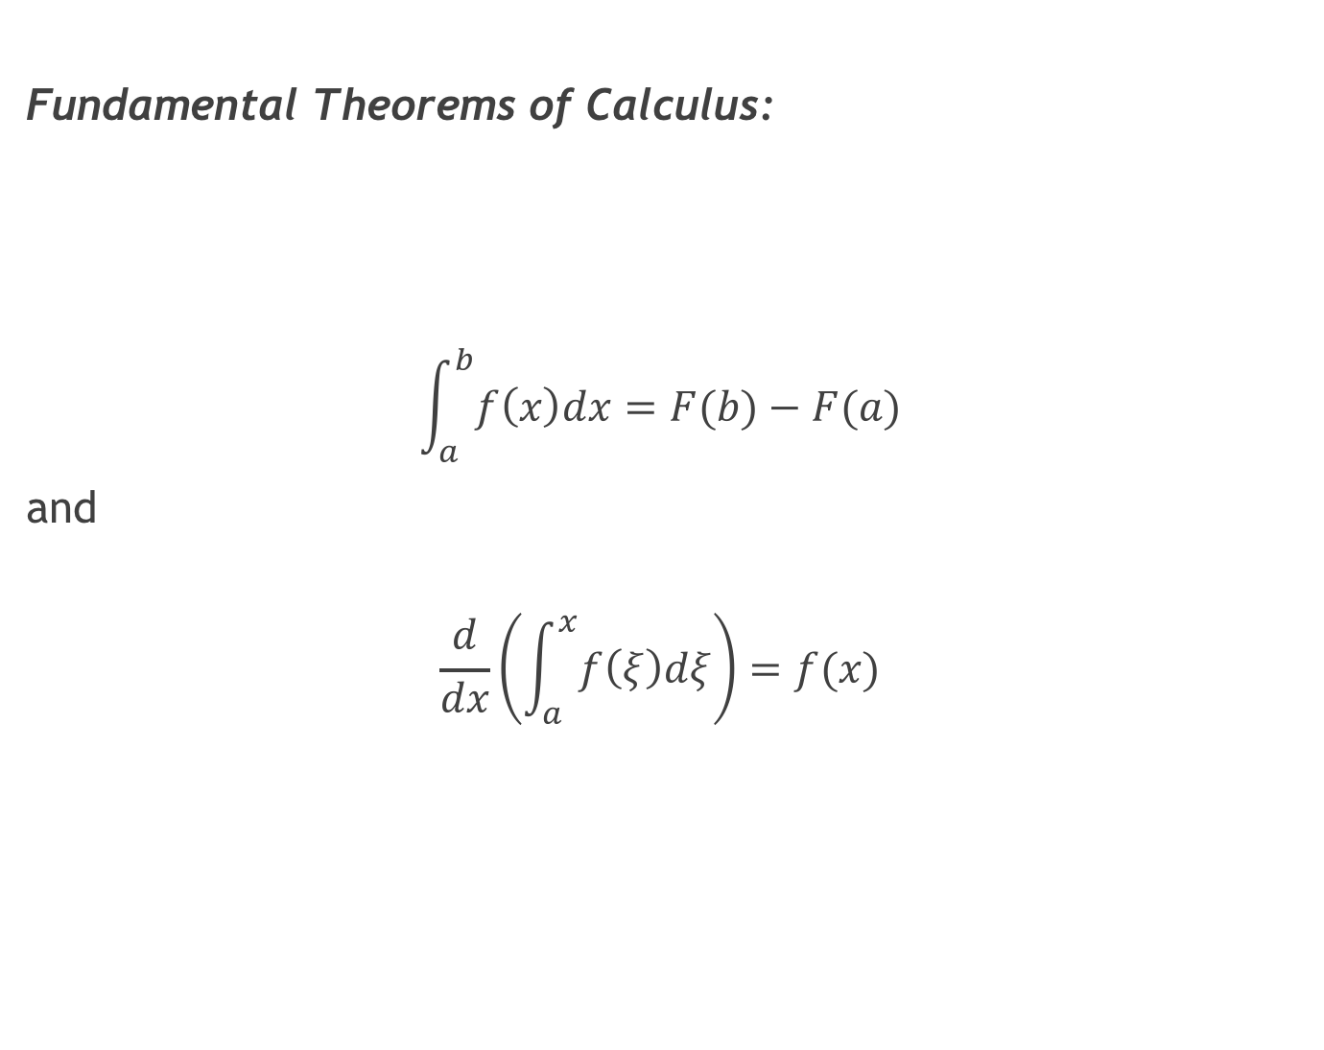
Fundamental Theorems of Calculus:
$$\int_{a}^{b}{f\left(x\right)dx=F(b)−F(a)}$$
and
$$\frac{d}{dx}\left(\int_{a}^{x}{f\left(ξ\right)dξ}\right)=f(x)$$

Slide 13
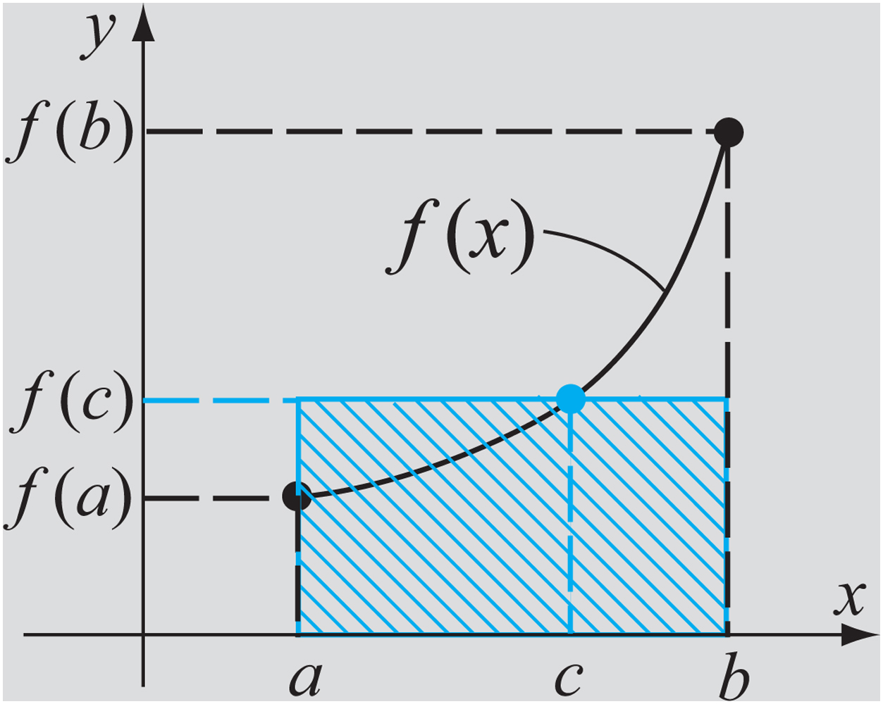
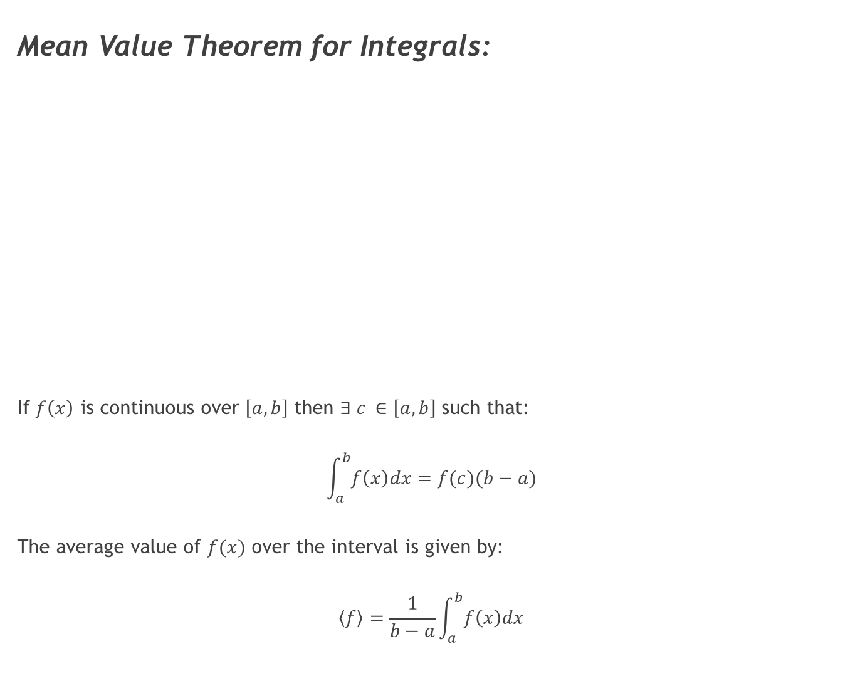
Mean Value Theorem for Integrals:
If $f\left(x\right)$ is continuous over $\left[a,b\right]$ then $∃ c ∈\left[a,b\right]$ such that:
$$\int_{a}^{b}{f\left(x\right)dx=f(c)(b−a)}$$
The average value of $f(x)$ over the interval is given by:
$$\left\langle f\right\rangle =\frac{1}{b−a}\int_{a}^{b}{f\left(x\right)dx}$$

Slide 14
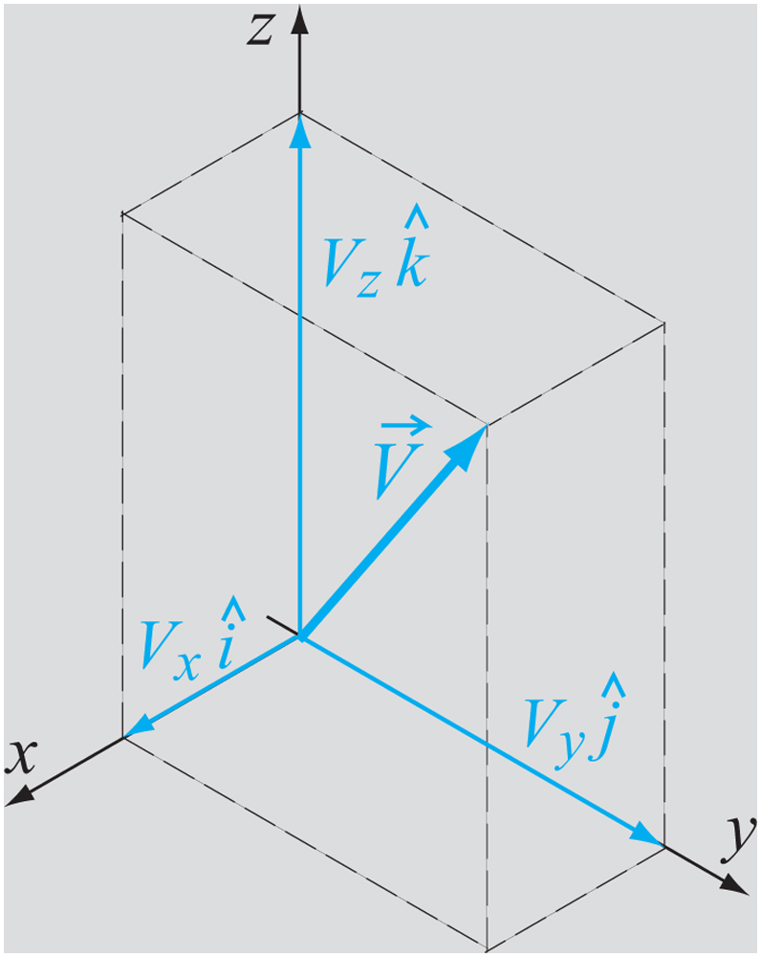
Vectors
Vectors are quantities that have a magnitude and a direction.
Examples are force, velocity and acceleration.
Scalars are quantities that have a magnitude only.
Examples are mass, speed and height.

Slide 15
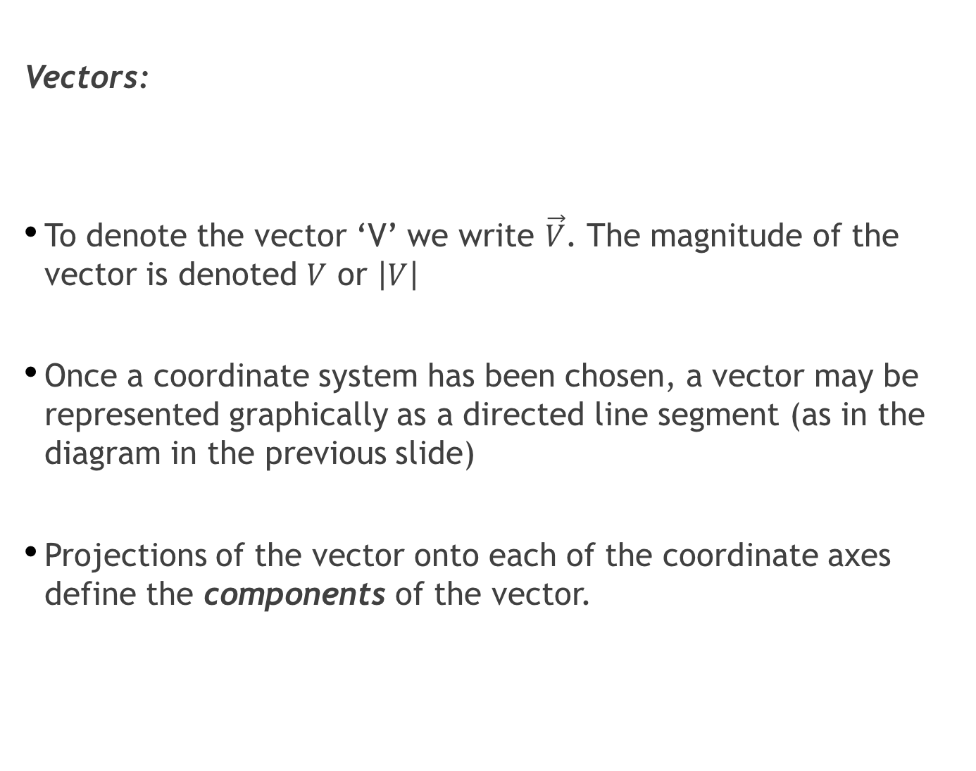
Vectors:
To denote the vector ‘V’ we write $\vec{V}$. The magnitude of the vector is denoted $V$ or $\left|V\right|$
Once a coordinate system has been chosen, a vector may be represented graphically as a directed line segment (as in the diagram in the previous slide)
Projections of the vector onto each of the coordinate axes define the components of the vector.

Slide 16
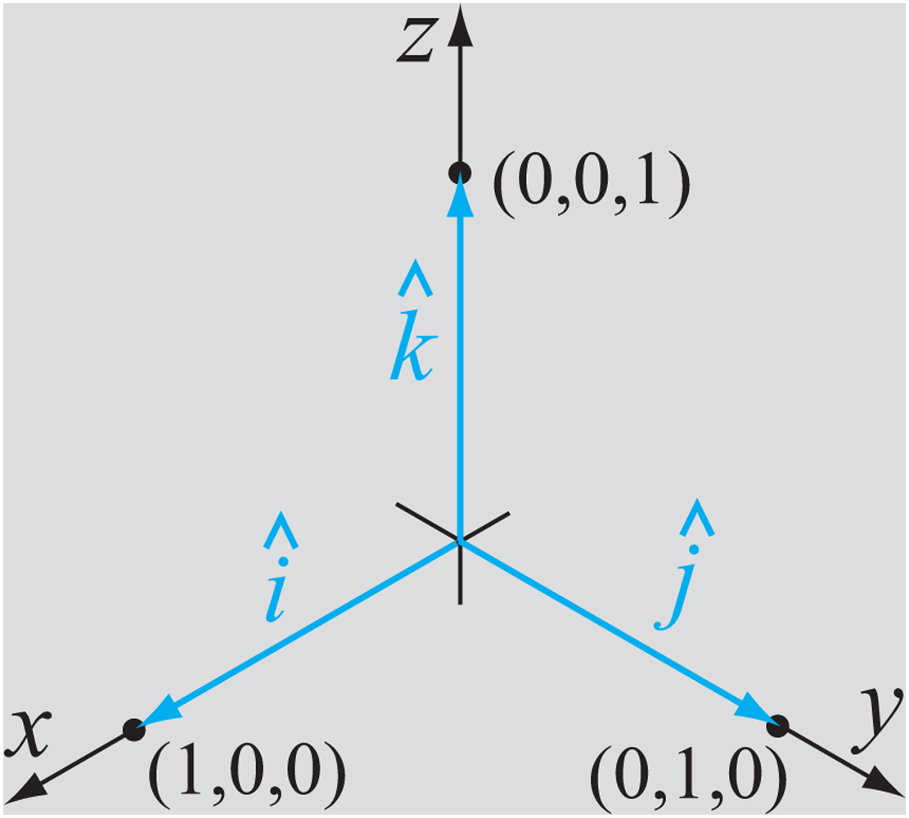
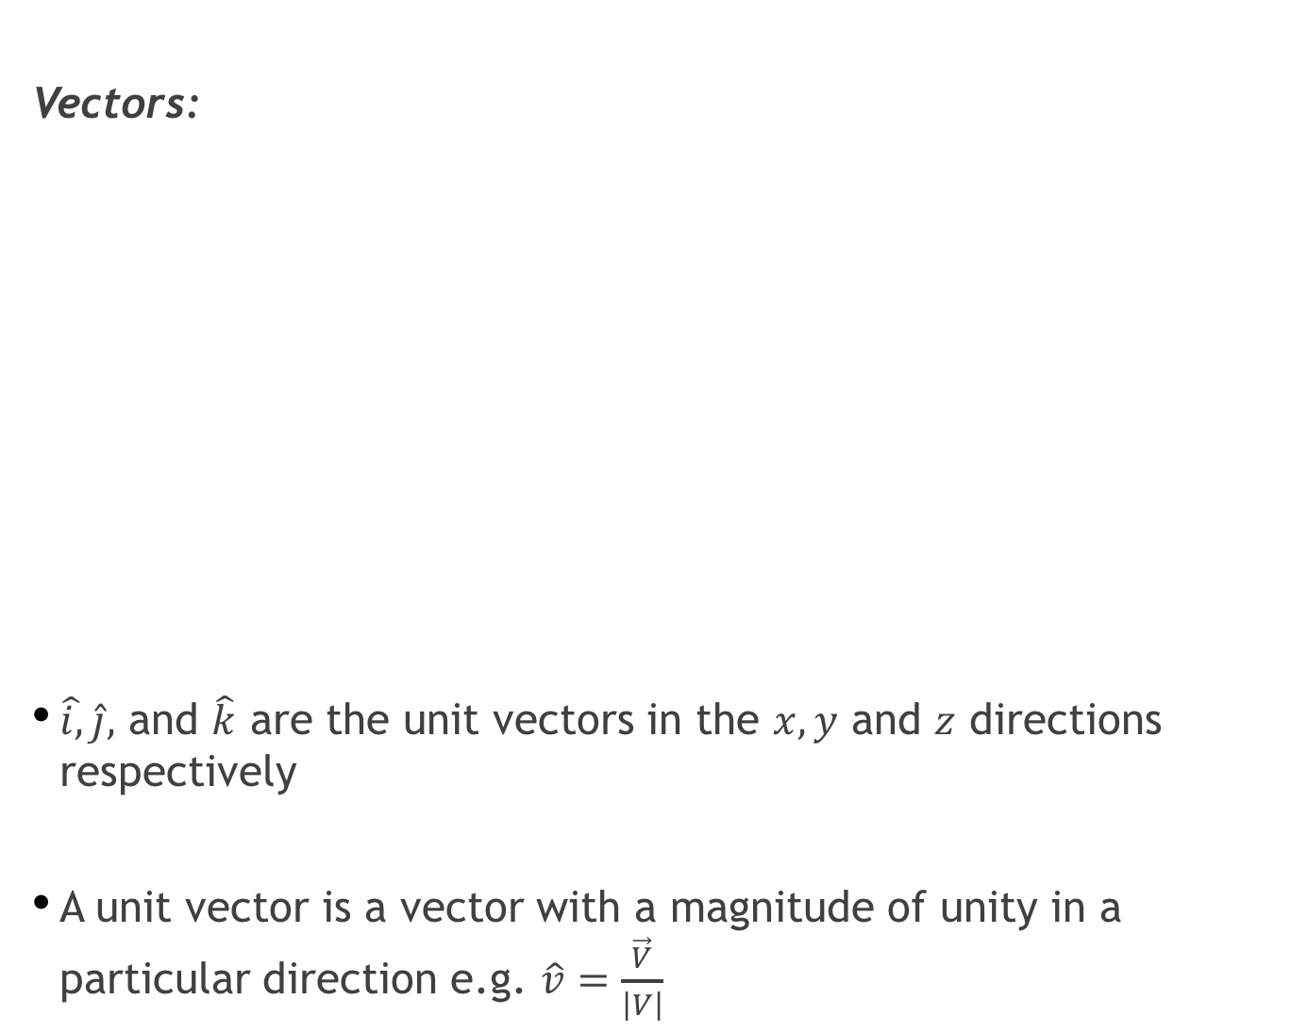
Vectors:
$\hat{i,}\hat{j},$ and $\hat{k}$ are the unit vectors in the $x,y$ and $z$ directions respectively
A unit vector is a vector with a magnitude of unity in a particular direction e.g. $\hat{v}=\frac{\vec{V}}{\left|V\right|}$
Notes:
V

Slide 17
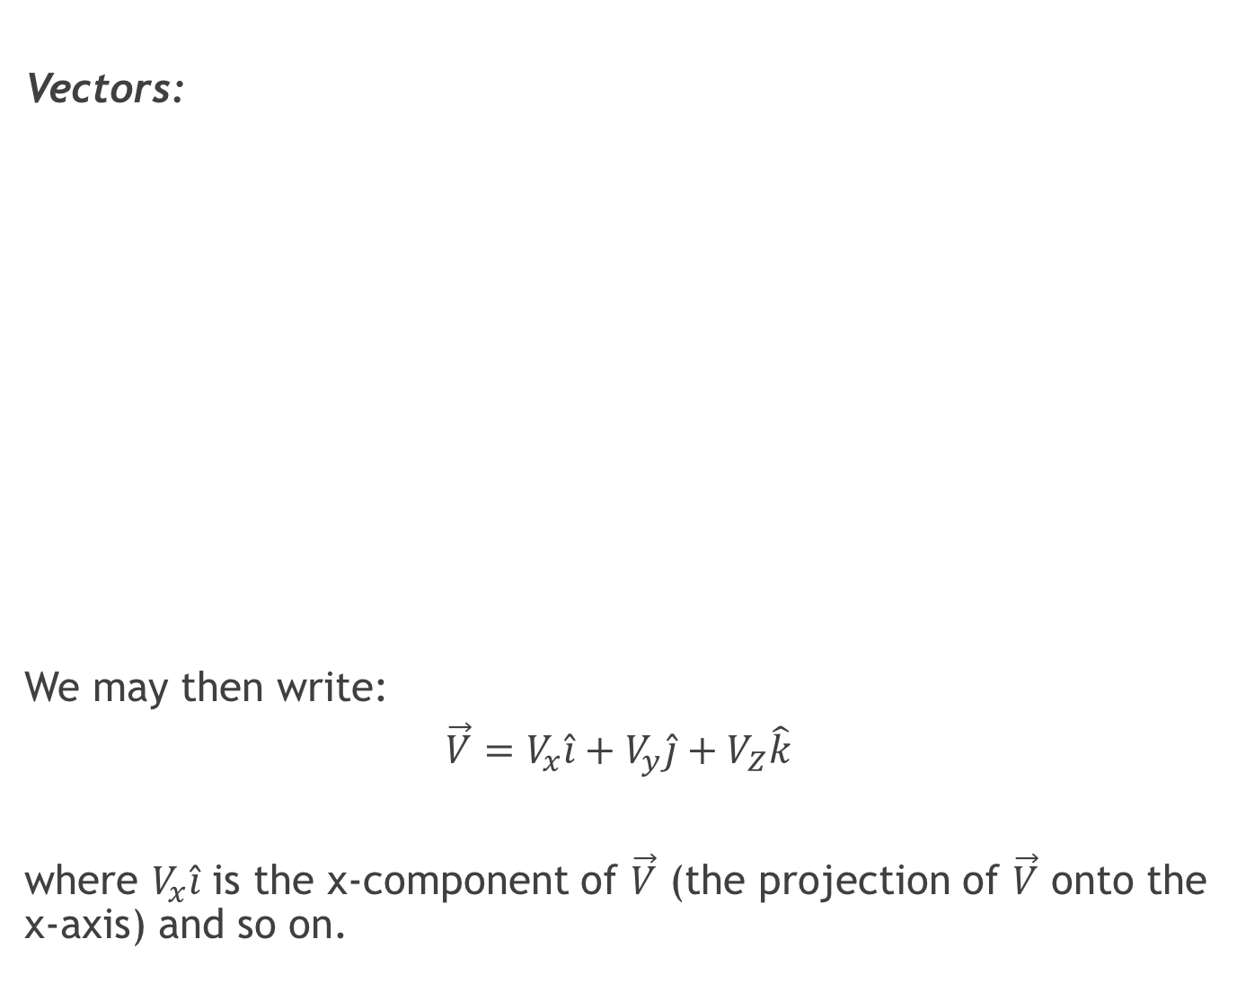
Vectors:
We may then write:
$$\vec{V}=V_{x}\hat{i}+V_{y}\hat{j}+V_{Z}\hat{k}$$
where $V_{x}\hat{i}$ is the x-component of $\vec{V}$ (the projection of $\vec{V}$ onto the x-axis) and so on.

Slide 18
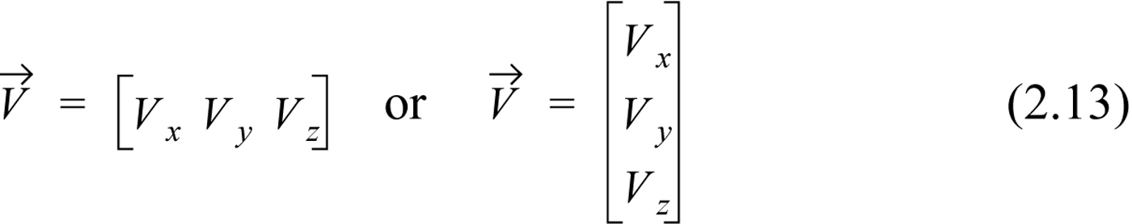
Vectors:
A vector may be written by listing the magnitudes of its components in a row or column:
The magnitude of a vector in three-dimensional Cartesian space is its length given by:

Slide 19
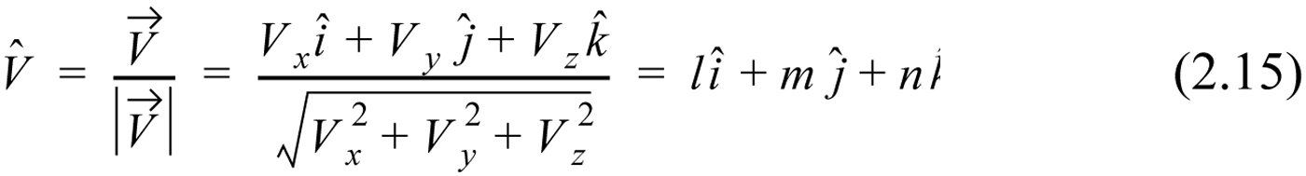
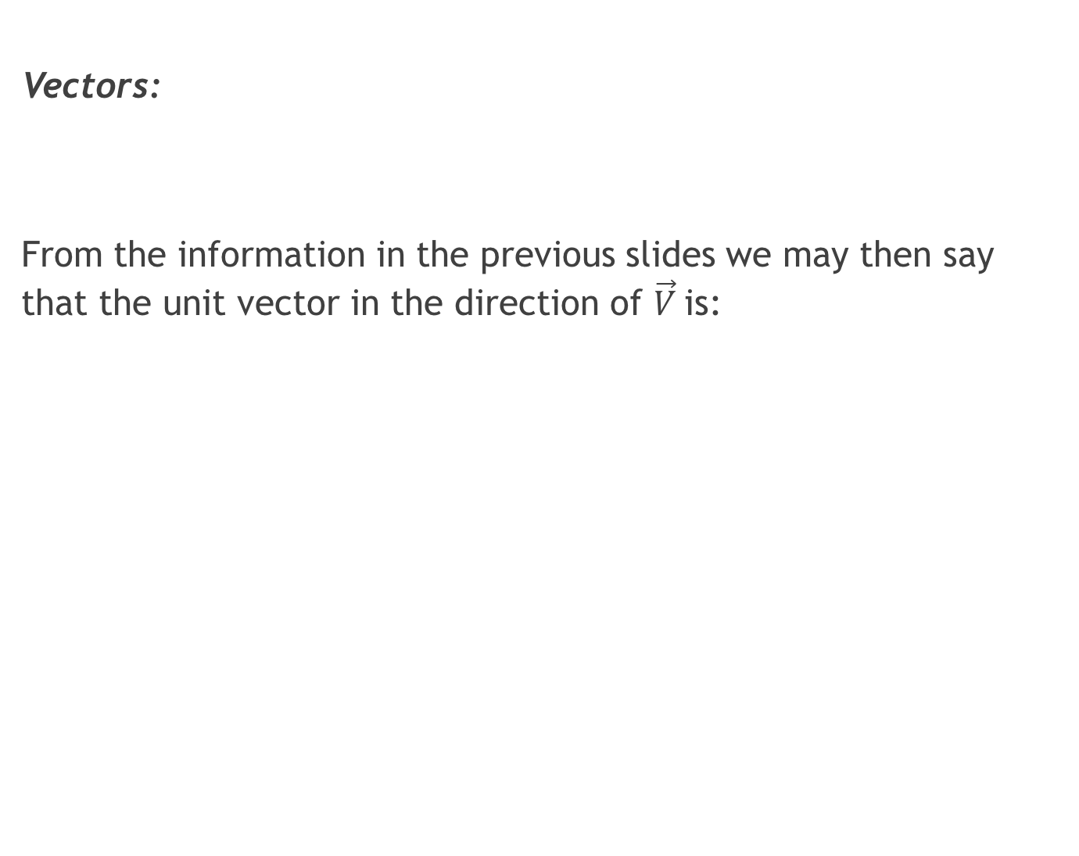
Vectors:
From the information in the previous slides we may then say that the unit vector in the direction of $\vec{V}$is:

Slide 20
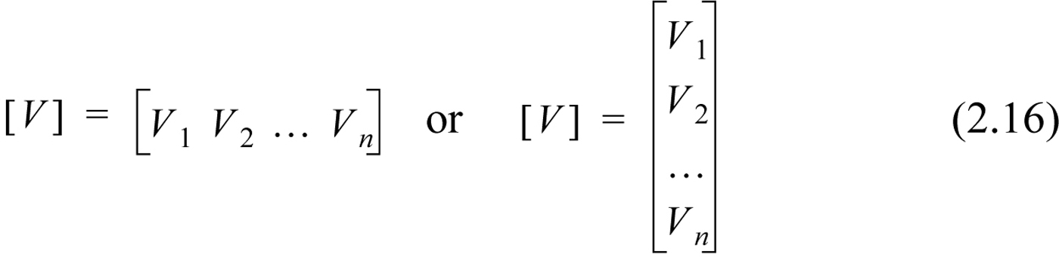
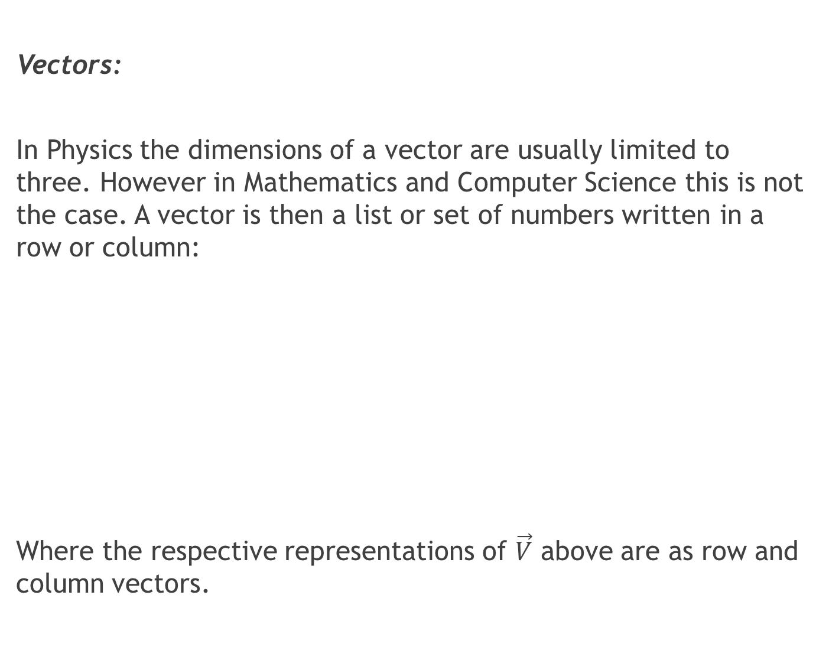
Vectors:
In Physics the dimensions of a vector are usually limited to three. However in Mathematics and Computer Science this is not the case. A vector is then a list or set of numbers written in a row or column:
Where the respective representations of $\vec{V}$ above are as row and column vectors.

Slide 21
Addition and Subtraction of Vectors:

Slide 22
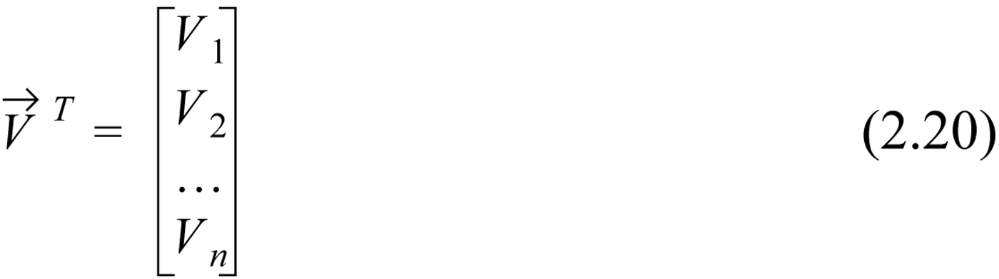
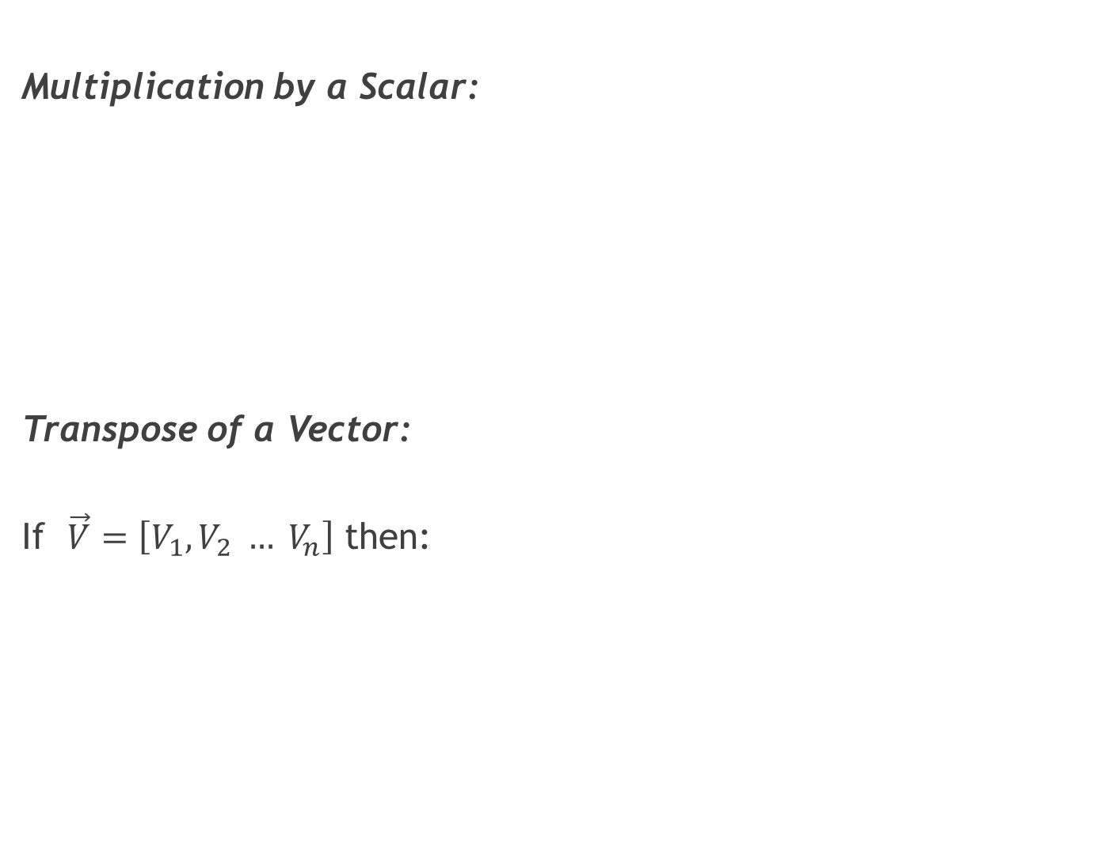
Multiplication by a Scalar:
Transpose of a Vector:
If $\vec{V}=\left[V_{1}, V_{2} … V_{n}\right]$ then:

Slide 23
Multiplication of Two Vectors:
The ‘Dot’ Product or Scalar Product:
or

Slide 24
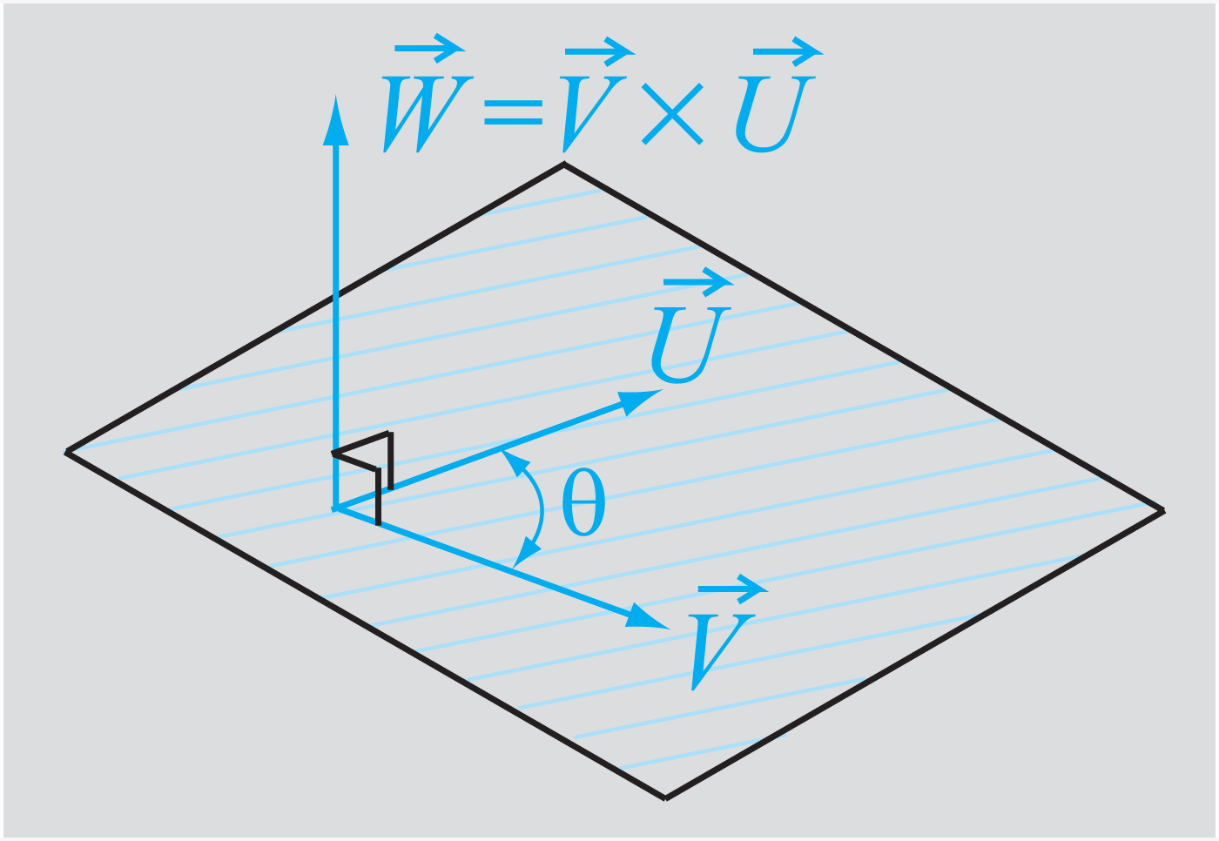
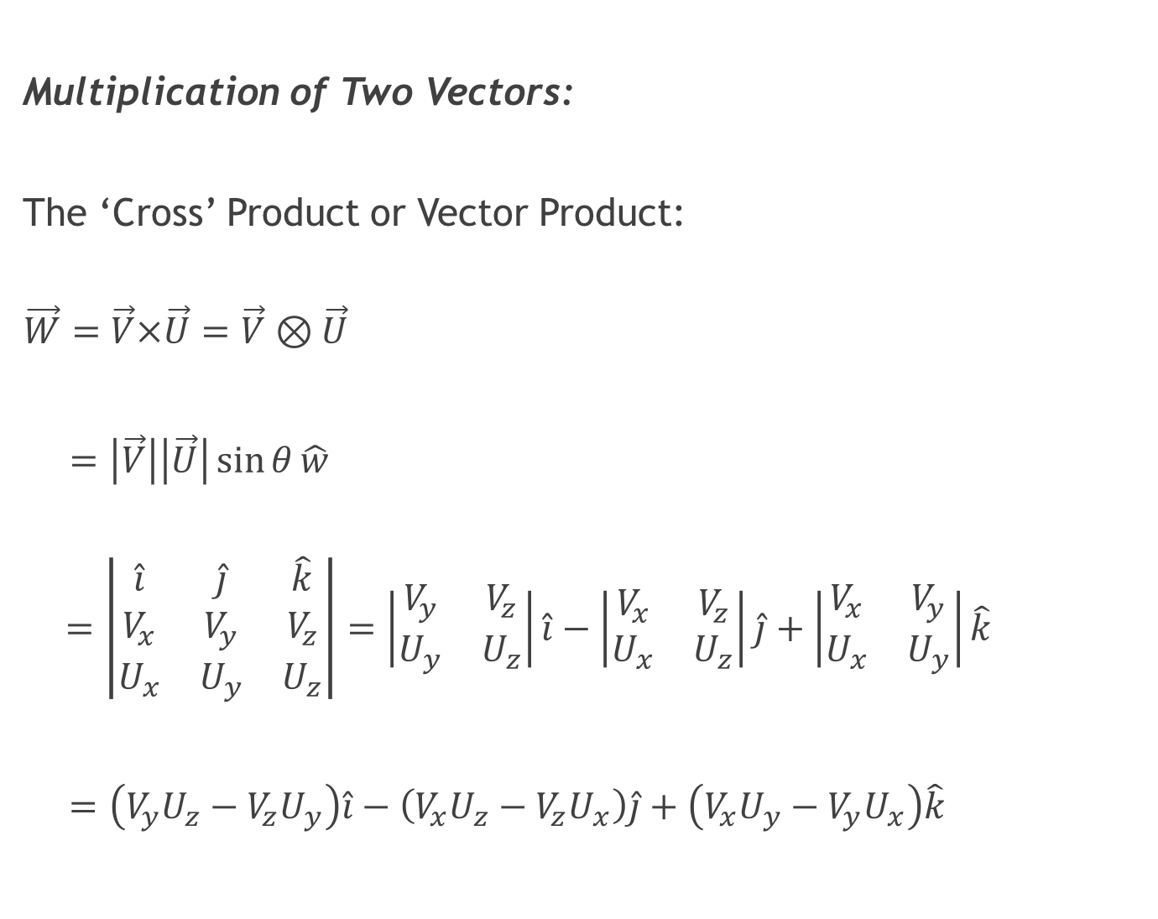
Multiplication of Two Vectors:
The ‘Cross’ Product or Vector Product:
$$\vec{W}=\vec{V}×\vec{U}=\vec{V}⊗\vec{U}$$
$=\left|\vec{V}\right|\left|\vec{U}\right|\sin{θ}\hat{w}$
$$=\left|\begin{matrix}\hat{i} & \hat{j} & \hat{k} \\ V_{x} & V_{y} & V_{z} \\ U_{x} & U_{y} & U_{z}\end{matrix}\right|=\left|\begin{matrix}V_{y} & V_{z} \\ U_{y} & U_{z}\end{matrix}\right|\hat{i}−\left|\begin{matrix}V_{x} & V_{z} \\ U_{x} & U_{z}\end{matrix}\right|\hat{j}+\left|\begin{matrix}V_{x} & V_{y} \\ U_{x} & U_{y}\end{matrix}\right|\hat{k}$$
$=\left(V_{y}U_{z}−V_{z}U_{y}\right)\hat{i}−\left(V_{x}U_{z}−V_{z}U_{x}\right)\hat{j}+\left(V_{x}U_{y}−V_{y}U_{x}\right)\hat{k}$

Slide 25
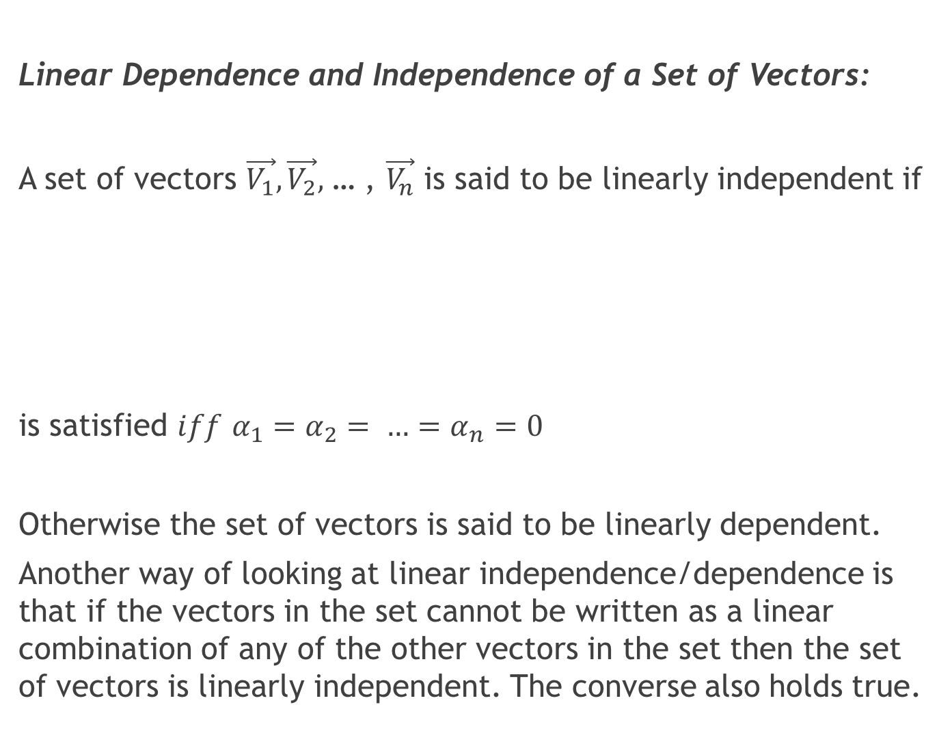
Linear Dependence and Independence of a Set of Vectors:
A set of vectors $\vec{V_{1}},\vec{V_{2}},$ … , $\vec{V_{n}}$ is said to be linearly independent if
is satisfied $iff$ $α_{1}=α_{2}= …=α_{n}=0$
Otherwise the set of vectors is said to be linearly dependent.
Another way of looking at linear independence/dependence is that if the vectors in the set cannot be written as a linear combination of any of the other vectors in the set then the set of vectors is linearly independent. The converse also holds true.

Slide 26
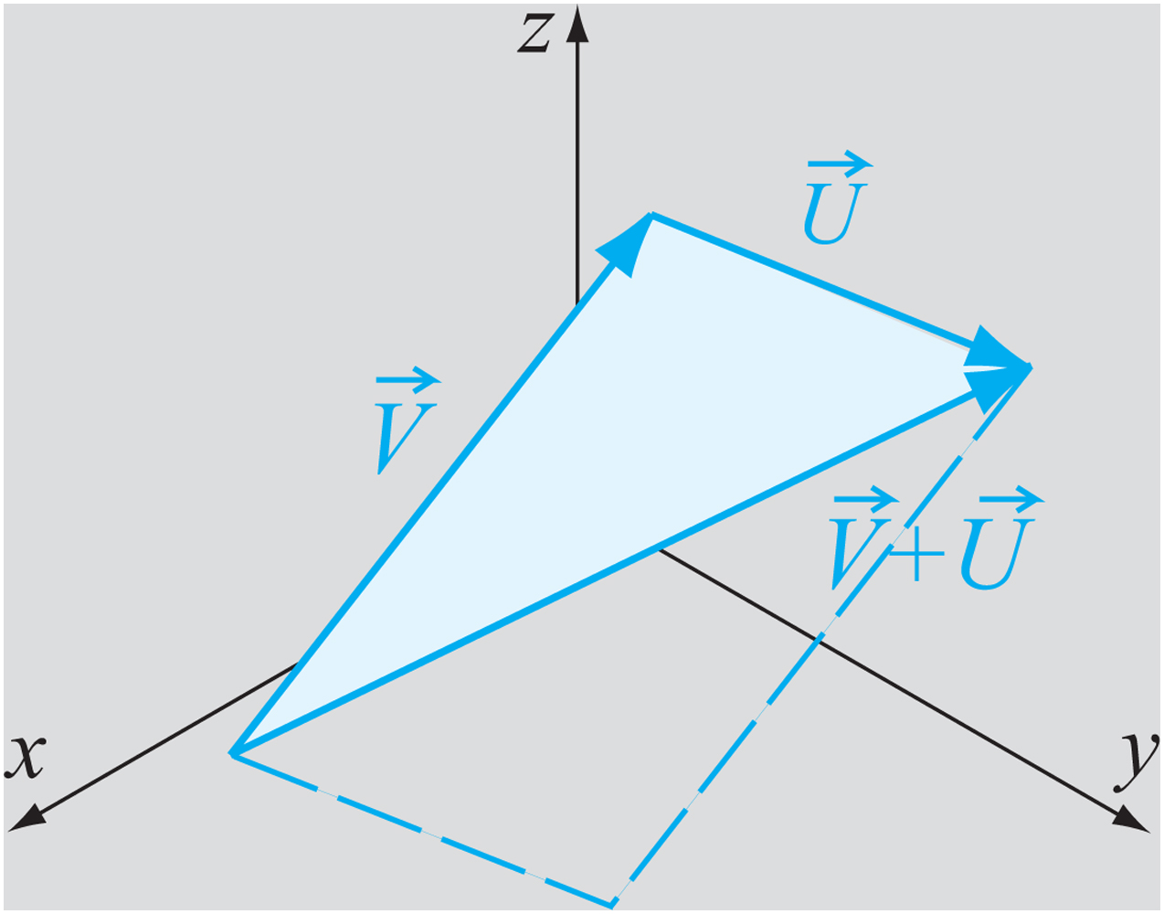
The Triangle Inequality:

Slide 27
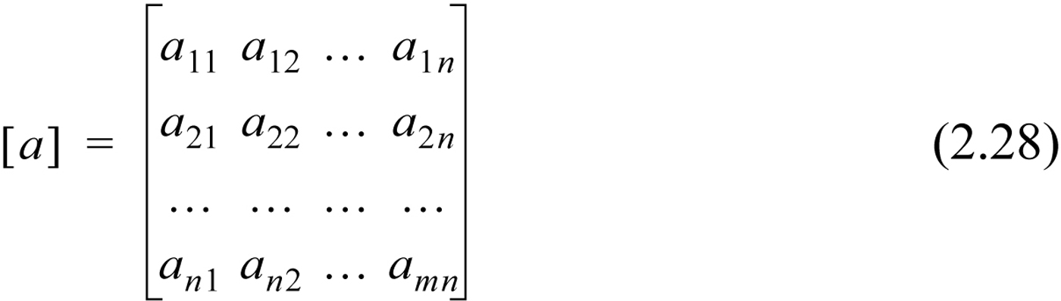
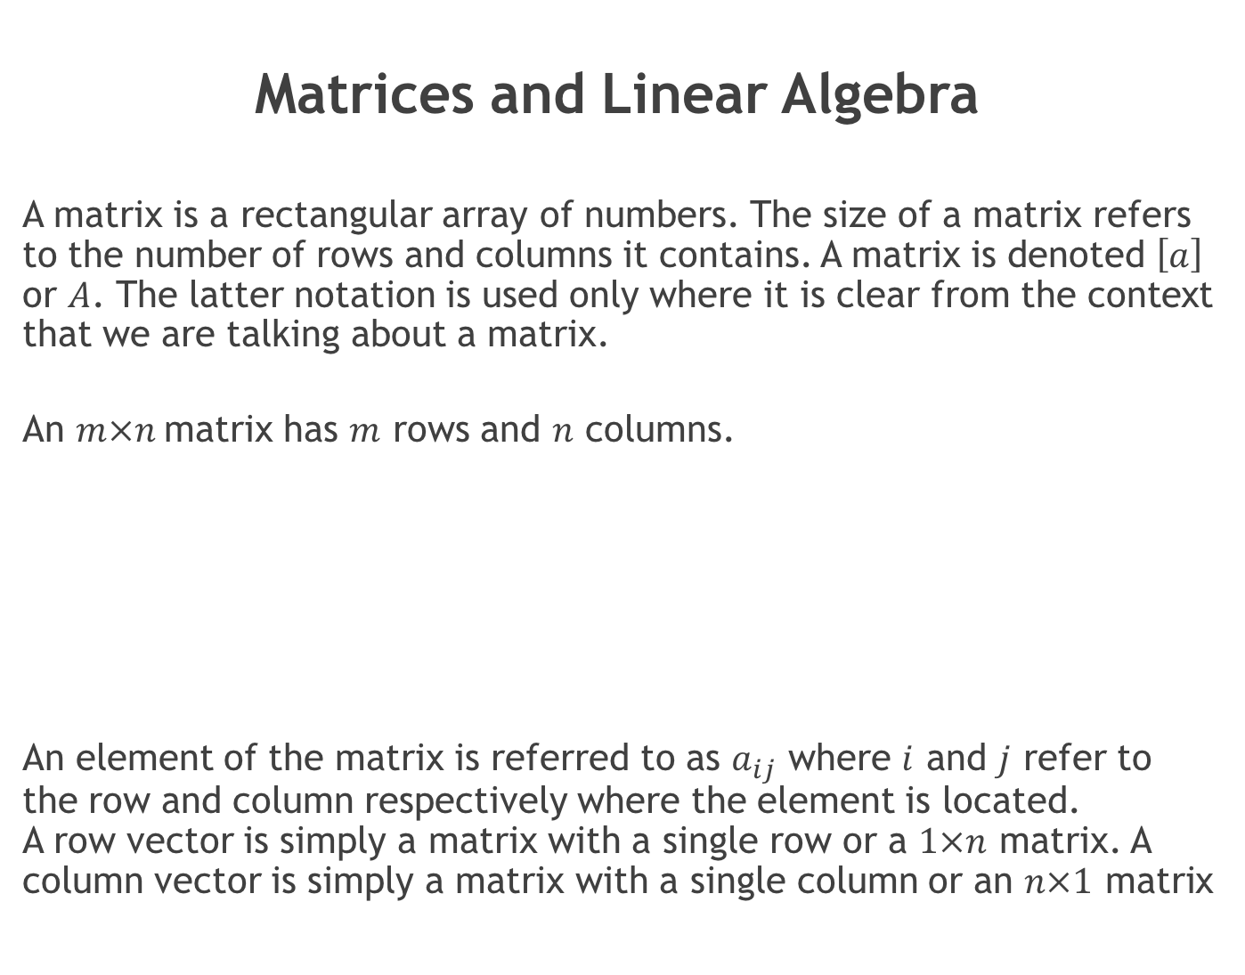
Matrices and Linear Algebra
A matrix is a rectangular array of numbers. The size of a matrix refers to the number of rows and columns it contains. A matrix is denoted $\left[a\right]$ or $A$. The latter notation is used only where it is clear from the context that we are talking about a matrix.
An $m×n$matrix has $m$ rows and $n$ columns.
An element of the matrix is referred to as $a_{ij}$ where $i$ and $j$ refer to the row and column respectively where the element is located. A row vector is simply a matrix with a single row or a $1×n$ matrix. A column vector is simply a matrix with a single column or an $n×1$ matrix

Slide 28
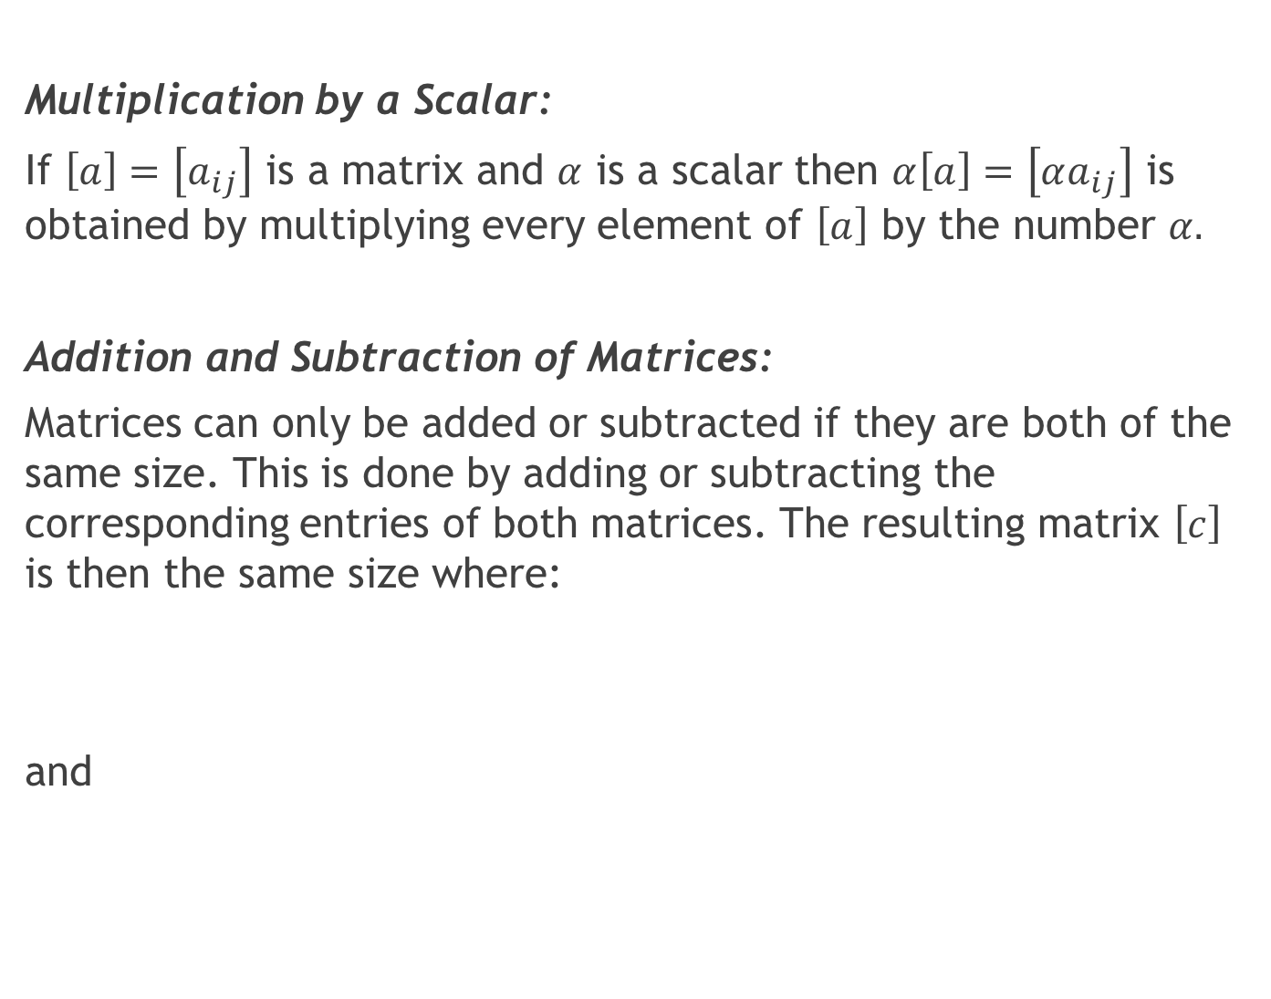
Multiplication by a Scalar:
If $\left[a\right]=\left[a_{ij}\right]$ is a matrix and $α$ is a scalar then $α\left[a\right]=\left[αa_{ij}\right]$ is obtained by multiplying every element of $\left[a\right]$ by the number $α.$
Addition and Subtraction of Matrices:
Matrices can only be added or subtracted if they are both of the same size. This is done by adding or subtracting the corresponding entries of both matrices. The resulting matrix $\left[c\right]$ is then the same size where:
and

Slide 29
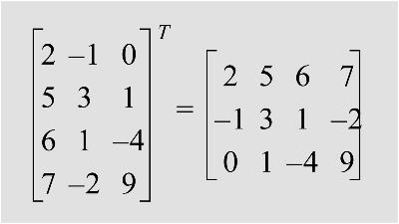
Transpose of a Matrix:
The transpose of a matrix is a matrix with the rows and columns interchanged. The first row becomes the first column of the transposed matrix and so on.

Slide 30
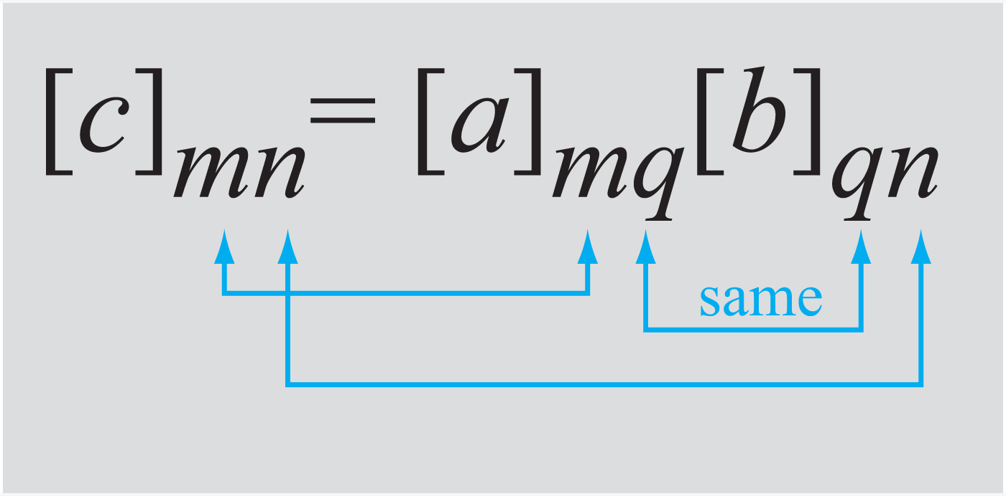
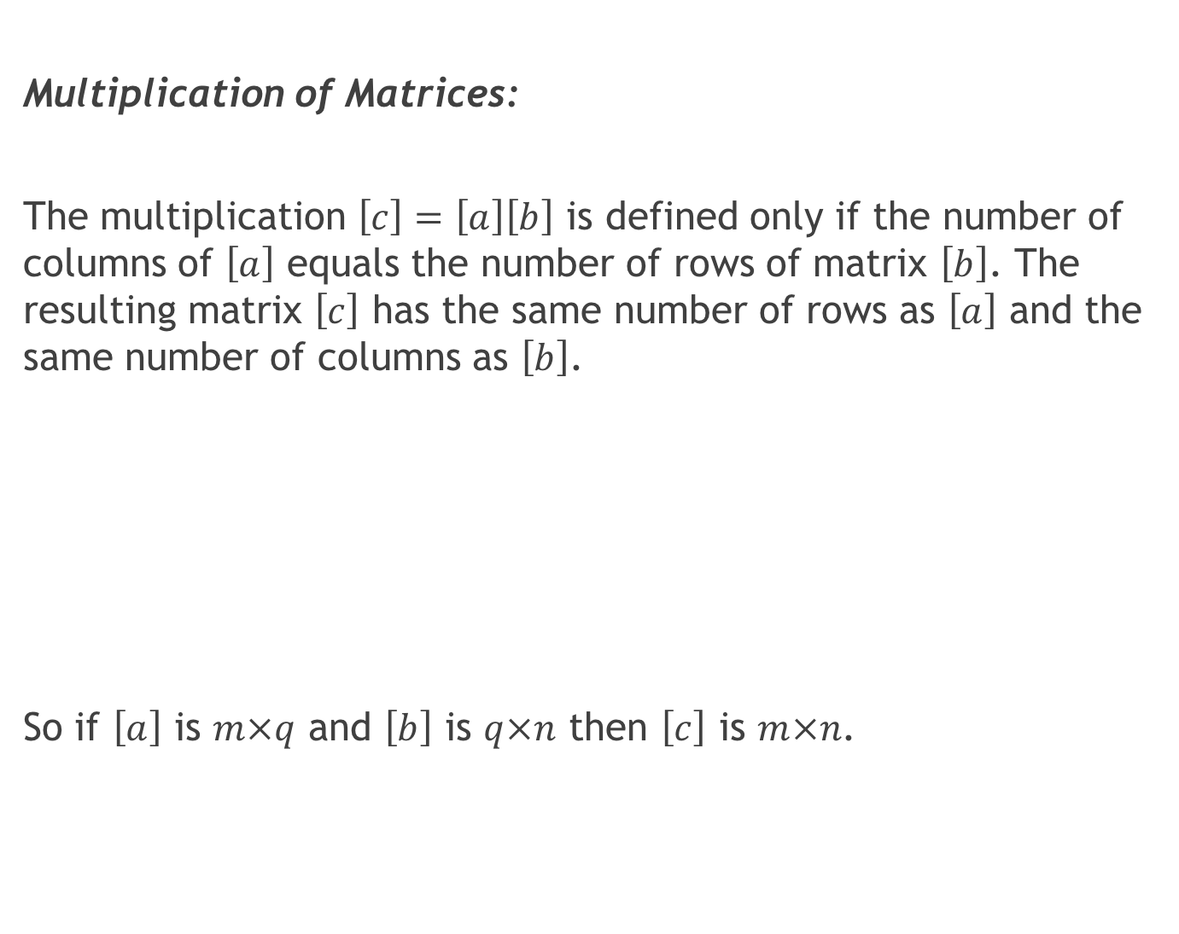
Multiplication of Matrices:
The multiplication $\left[c\right]=\left[a\right]\left[b\right]$ is defined only if the number of columns of $\left[a\right]$ equals the number of rows of matrix $\left[b\right]$. The resulting matrix $\left[c\right]$ has the same number of rows as $\left[a\right]$ and the same number of columns as $\left[b\right]$.
So if $\left[a\right]$ is $m×q$ and $\left[b\right]$ is $q×n$ then $\left[c\right]$ is $m×n$.

Slide 31
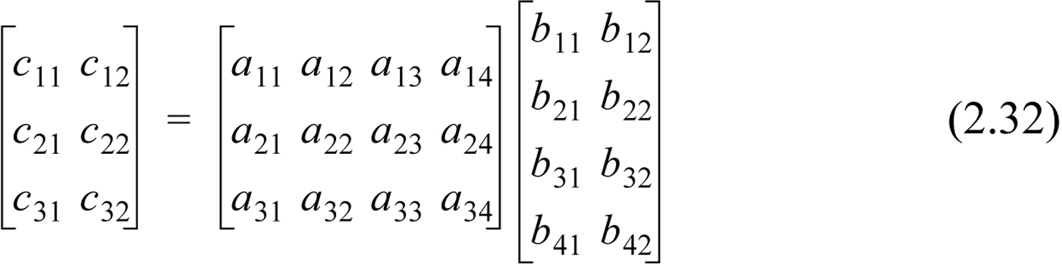
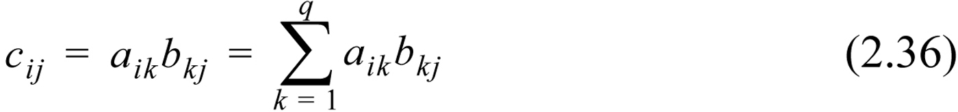
Multiplication of Matrices:
etc. In general:

Slide 32
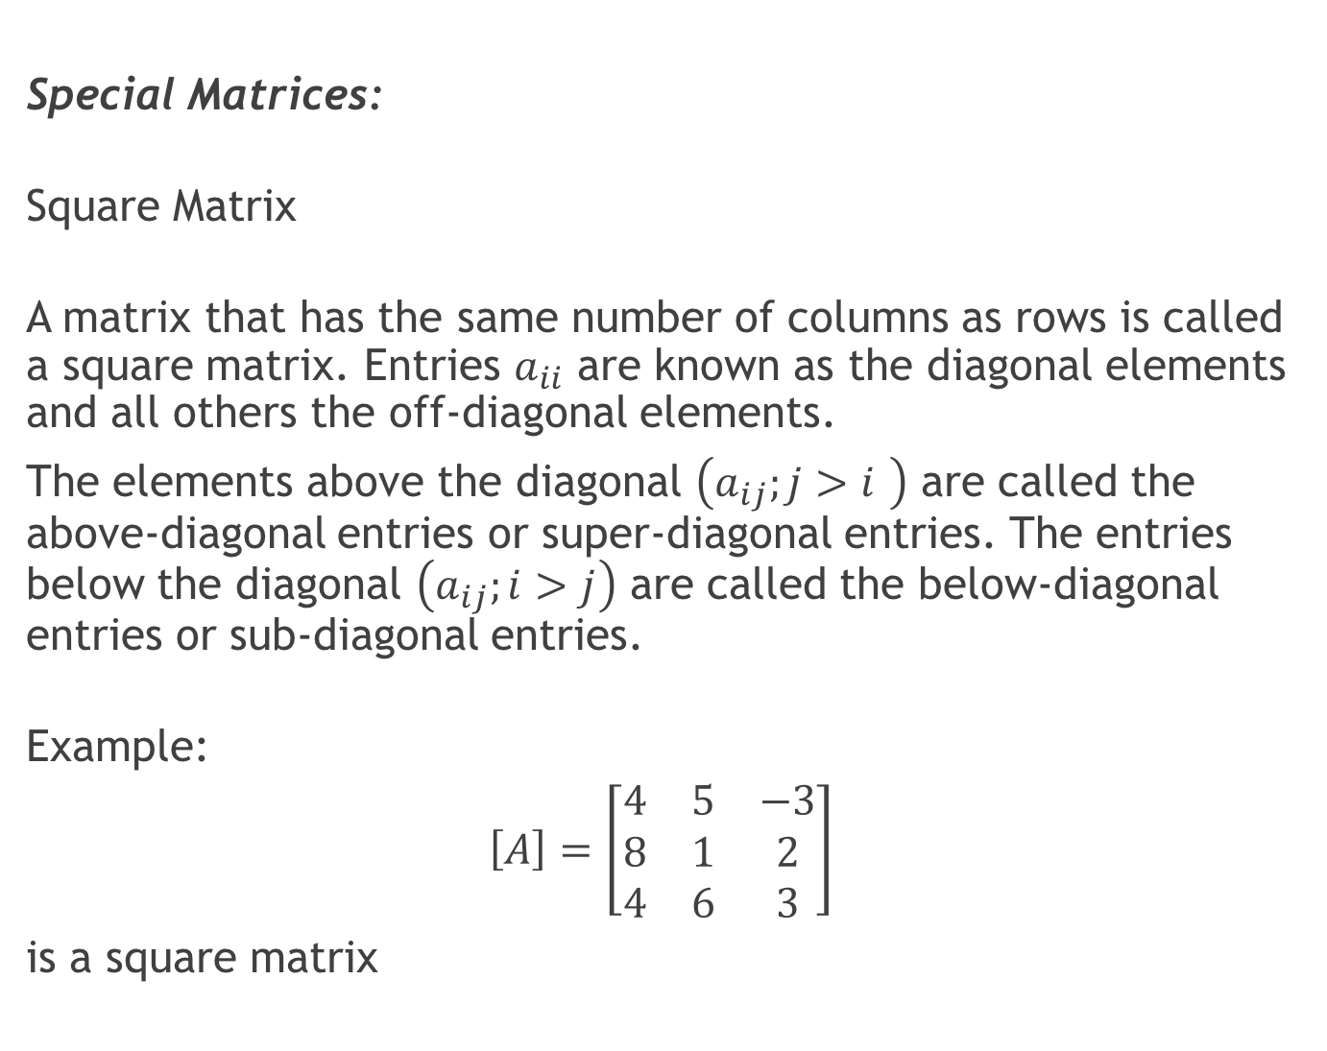
Special Matrices:
Square Matrix
A matrix that has the same number of columns as rows is called a square matrix. Entries $a_{ii}$ are known as the diagonal elements and all others the off-diagonal elements.
The elements above the diagonal $\left(a_{ij};j>i \right)$ are called the above-diagonal entries or super-diagonal entries. The entries below the diagonal $\left(a_{ij};i>j\right)$ are called the below-diagonal entries or sub-diagonal entries.
Example:
$$\left[A\right]=\left[\begin{matrix}4 & 5 & −3 \\ 8 & 1 & 2 \\ 4 & 6 & 3\end{matrix}\right]$$
is a square matrix

Slide 33
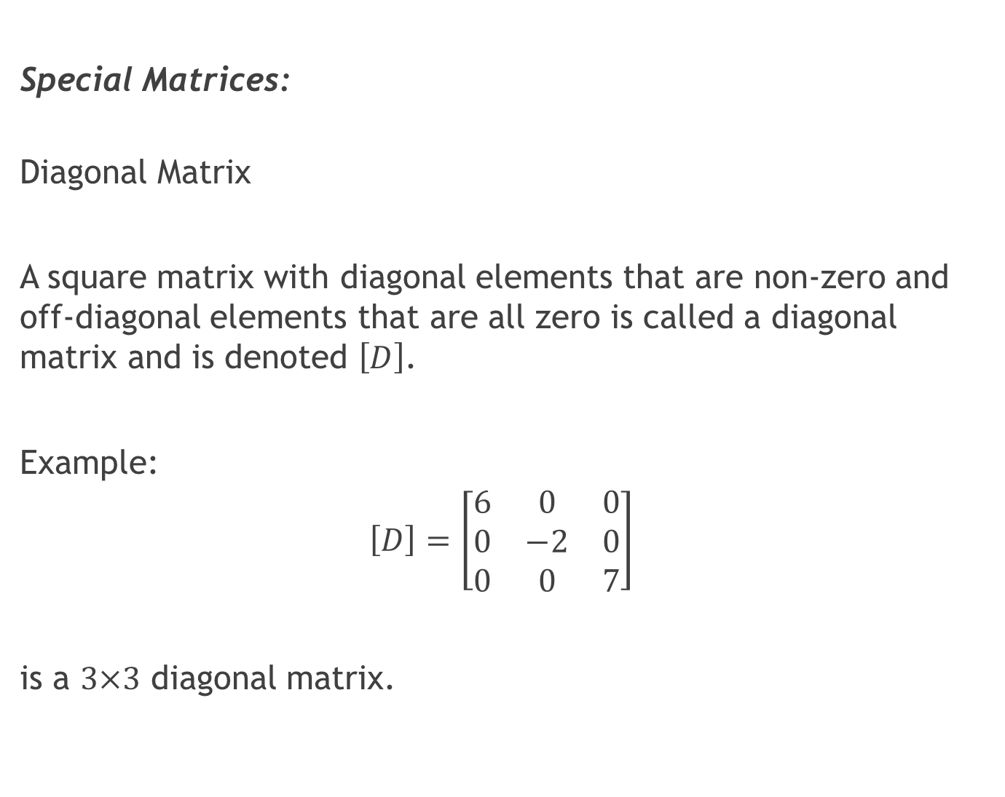
Special Matrices:
Diagonal Matrix
A square matrix with diagonal elements that are non-zero and off-diagonal elements that are all zero is called a diagonal matrix and is denoted $\left[D\right]$.
Example:
$$\left[D\right]=\left[\begin{matrix}6 & 0 & 0 \\ 0 & −2 & 0 \\ 0 & 0 & 7\end{matrix}\right]$$
is a $3×3$ diagonal matrix.

Slide 34
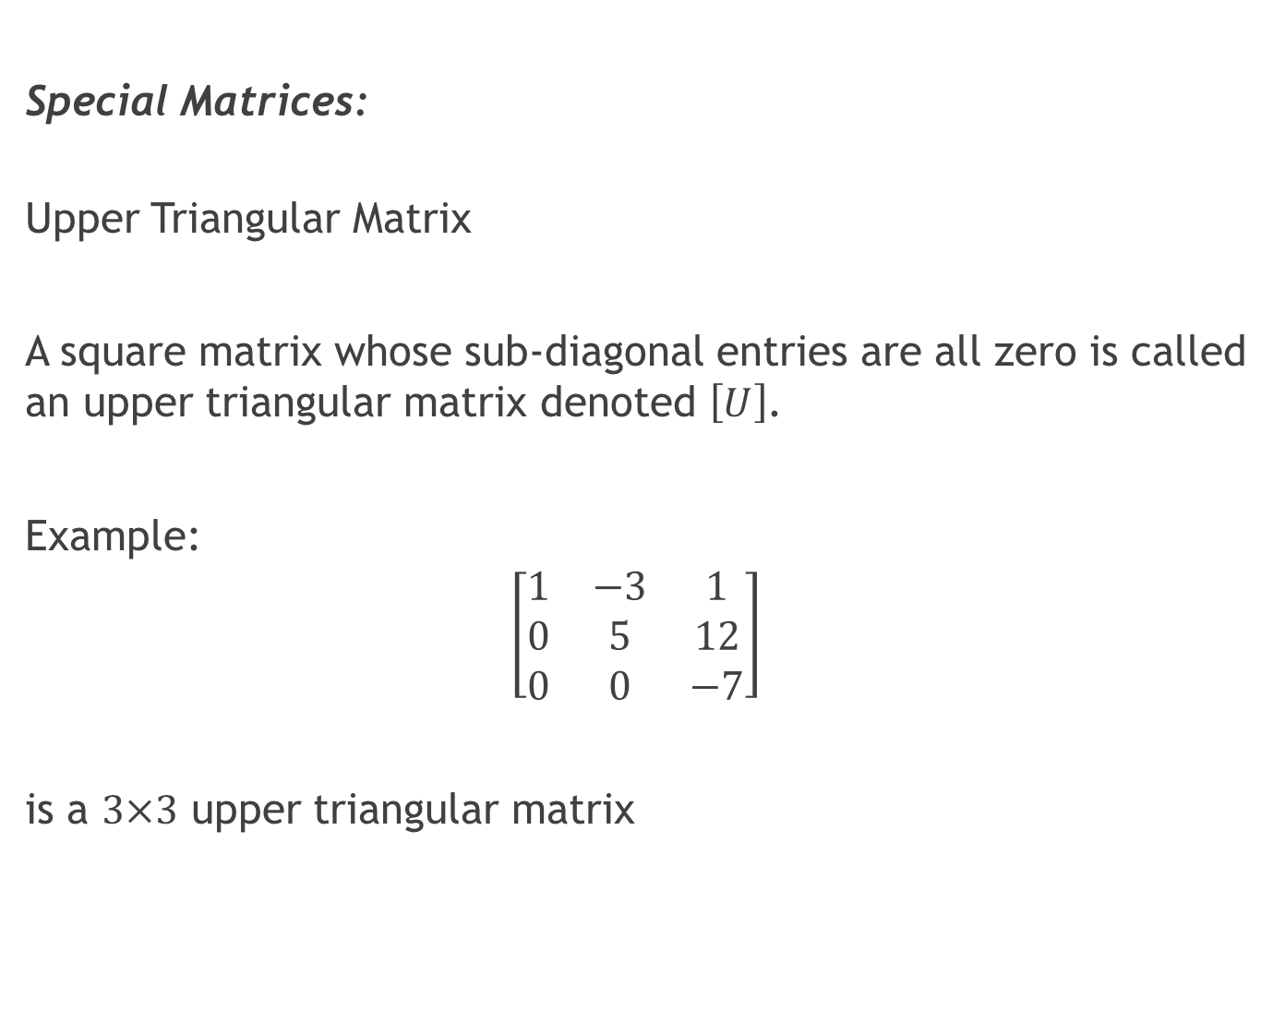
Special Matrices:
Upper Triangular Matrix
A square matrix whose sub-diagonal entries are all zero is called an upper triangular matrix denoted $\left[U\right]$.
Example:
$$\left[\begin{matrix}1 & −3 & 1 \\ 0 & 5 & 12 \\ 0 & 0 & −7\end{matrix}\right]$$
is a $3×3$ upper triangular matrix

Slide 35
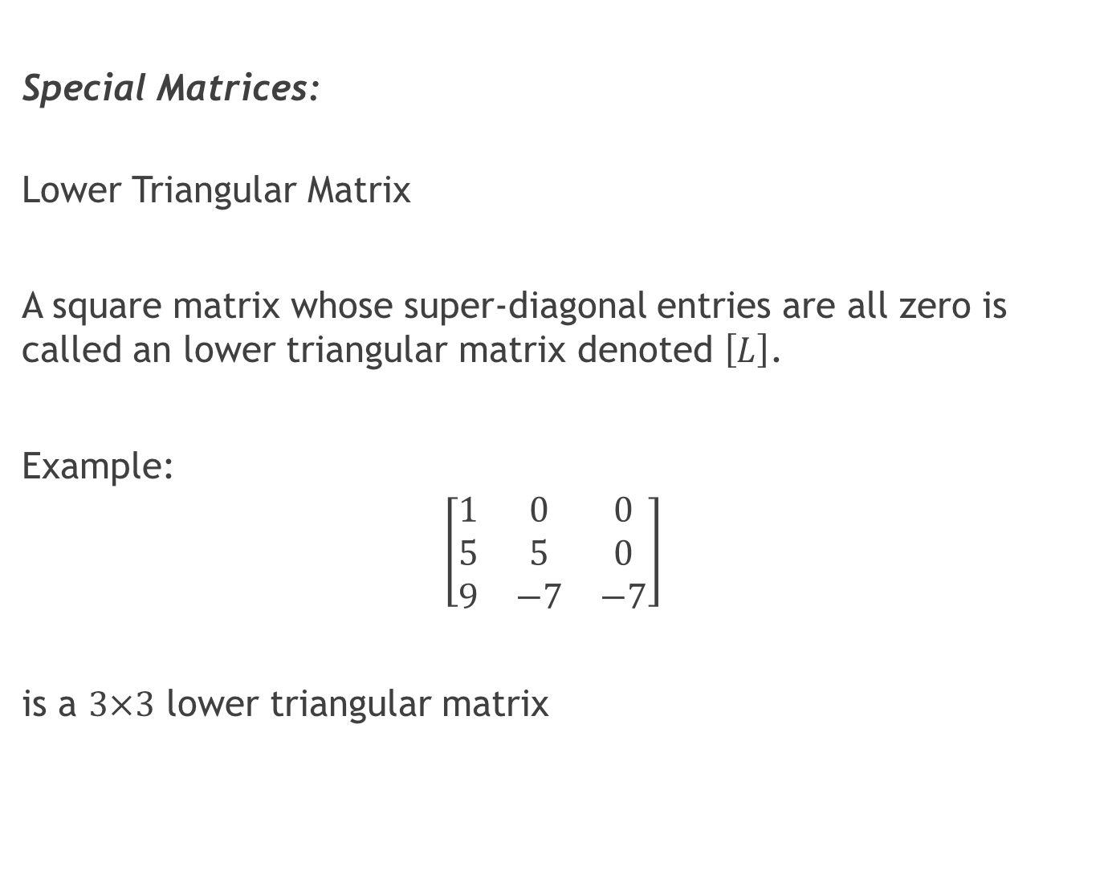
Special Matrices:
Lower Triangular Matrix
A square matrix whose super-diagonal entries are all zero is called an lower triangular matrix denoted $\left[L\right]$.
Example:
$$\left[\begin{matrix}1 & 0 & 0 \\ 5 & 5 & 0 \\ 9 & −7 & −7\end{matrix}\right]$$
is a $3×3$ lower triangular matrix

Slide 36
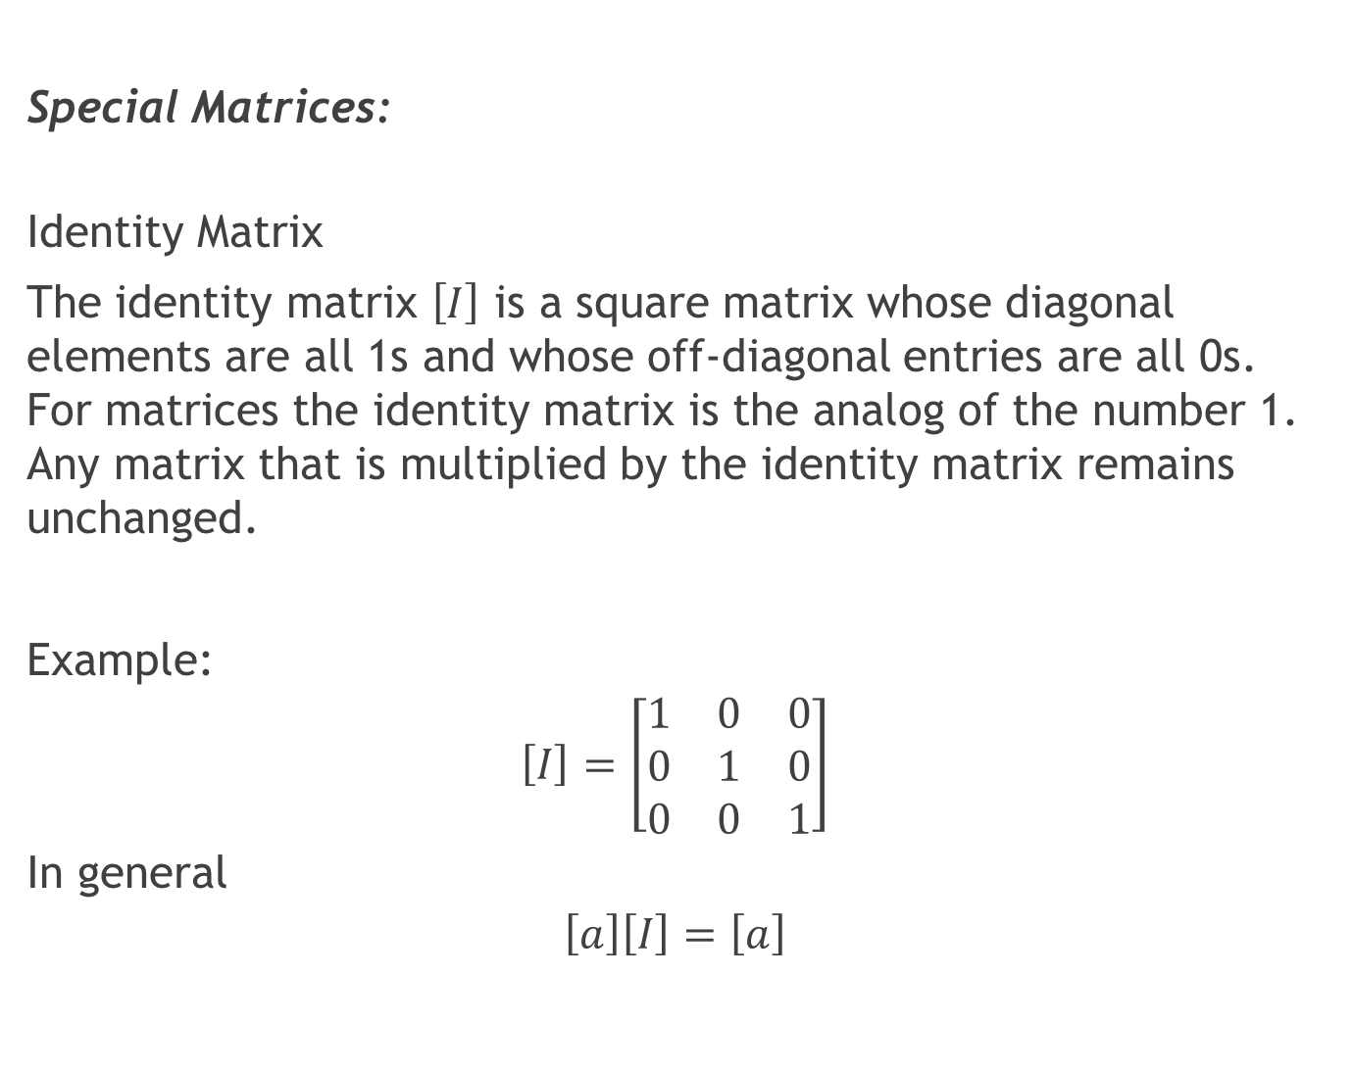
Special Matrices:
Identity Matrix
The identity matrix $\left[I\right]$ is a square matrix whose diagonal elements are all 1s and whose off-diagonal entries are all 0s. For matrices the identity matrix is the analog of the number 1. Any matrix that is multiplied by the identity matrix remains unchanged.
Example:
$$\left[I\right]=\left[\begin{matrix}1 & 0 & 0 \\ 0 & 1 & 0 \\ 0 & 0 & 1\end{matrix}\right]$$
In general
$$\left[a\right]\left[I\right]=\left[a\right]$$

Slide 37
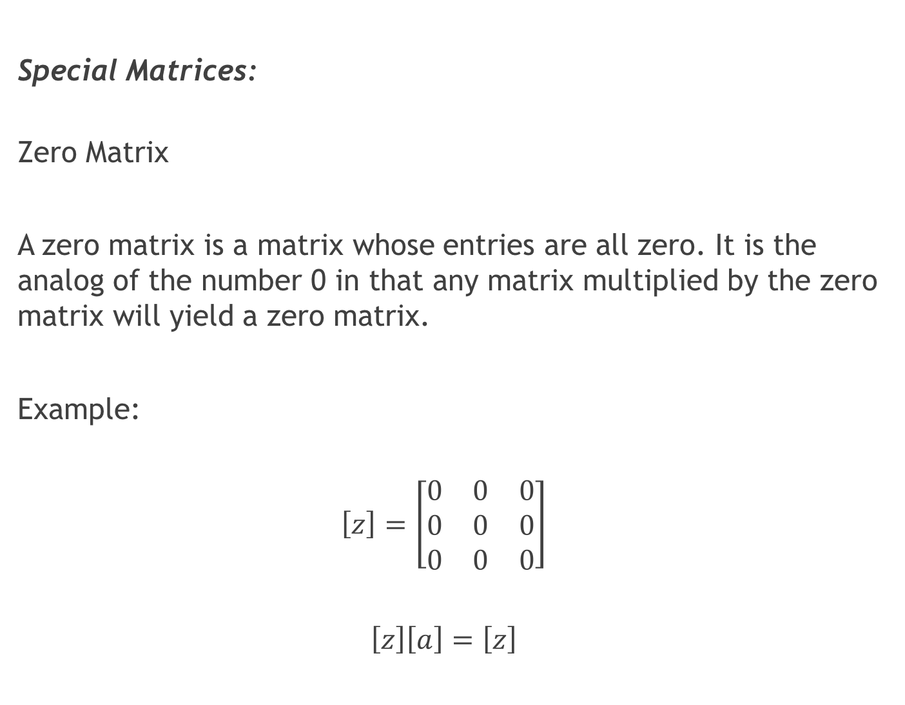
Special Matrices:
Zero Matrix
A zero matrix is a matrix whose entries are all zero. It is the analog of the number 0 in that any matrix multiplied by the zero matrix will yield a zero matrix.
Example:
$$\left[z\right]=\left[\begin{matrix}0 & 0 & 0 \\ 0 & 0 & 0 \\ 0 & 0 & 0\end{matrix}\right]$$
$$\left[z\right]\left[a\right]=\left[z\right]$$

Slide 38
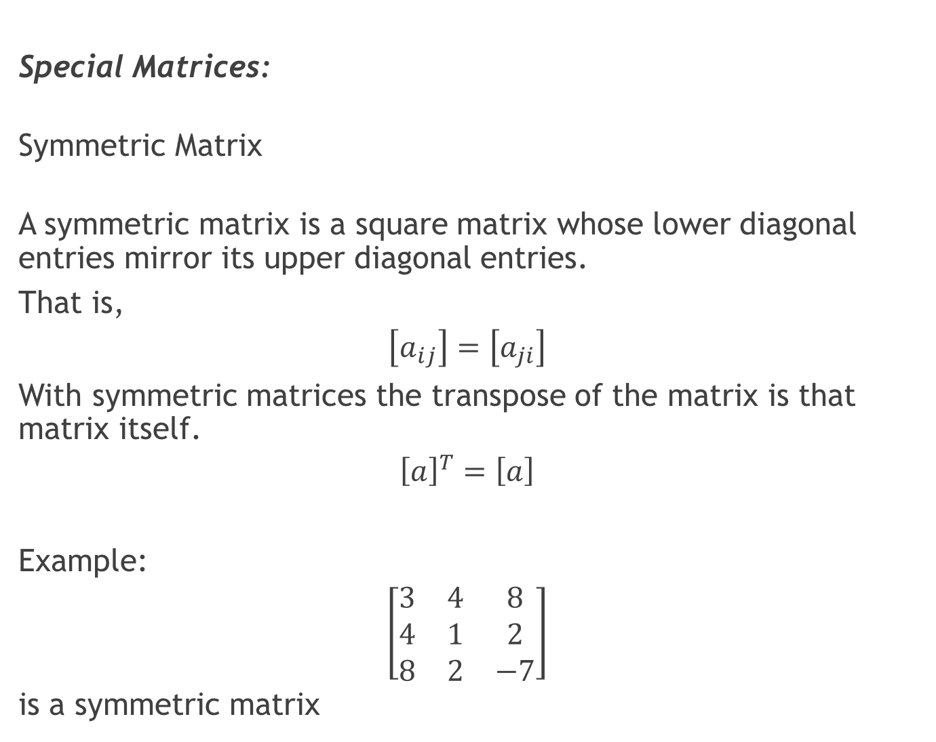
Special Matrices:
Symmetric Matrix
A symmetric matrix is a square matrix whose lower diagonal entries mirror its upper diagonal entries.
That is,
$$\left[a_{ij}\right]=\left[a_{ji}\right]$$
With symmetric matrices the transpose of the matrix is that matrix itself.
$${\left[a\right]}^{T}=\left[a\right]$$
Example:
$$\left[\begin{matrix}3 & 4 & 8 \\ 4 & 1 & 2 \\ 8 & 2 & −7\end{matrix}\right]$$
is a symmetric matrix

Slide 39
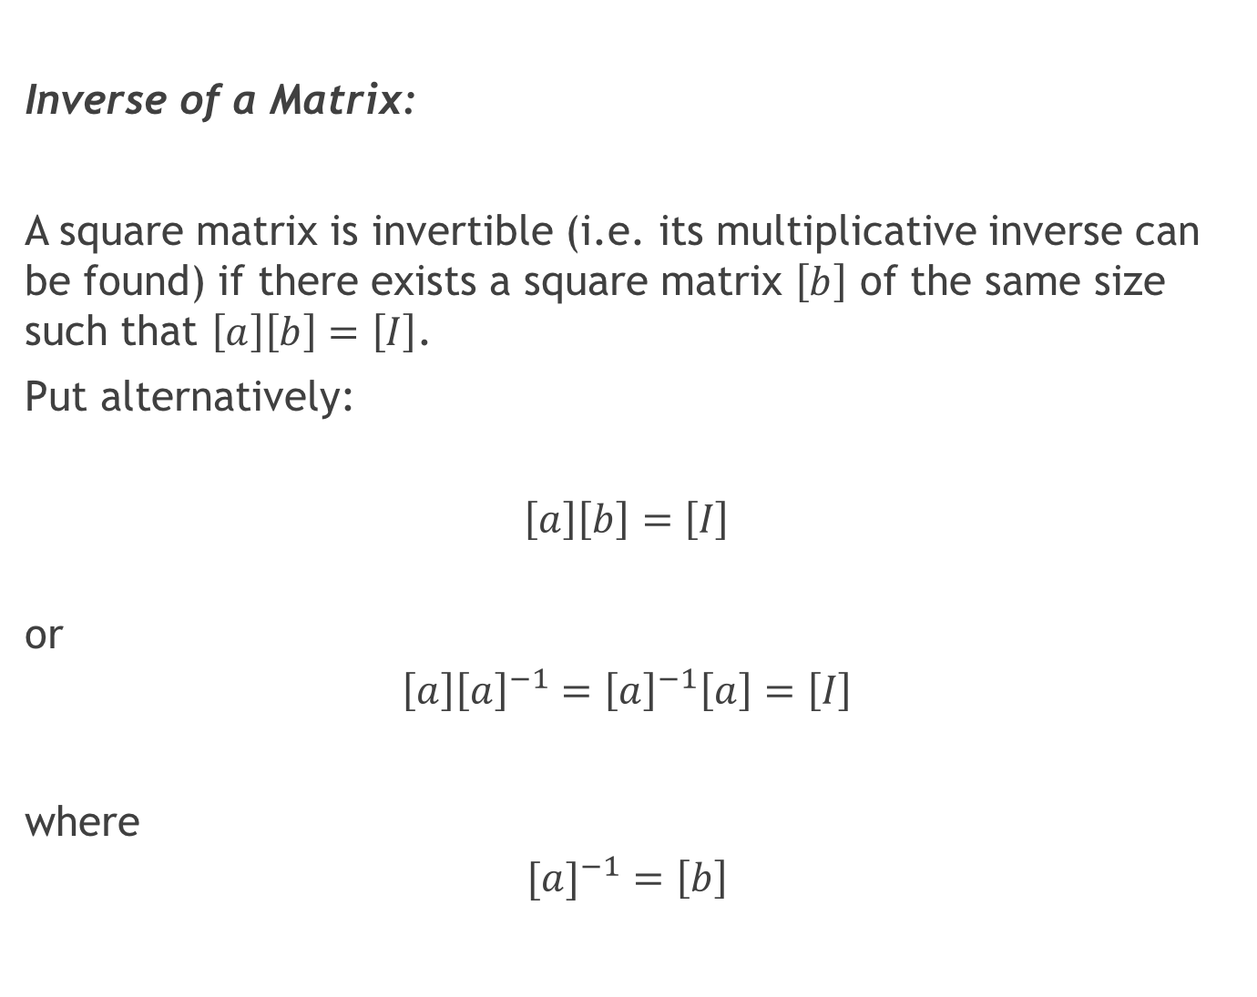
Inverse of a Matrix:
A square matrix is invertible (i.e. its multiplicative inverse can be found) if there exists a square matrix $\left[b\right]$ of the same size such that $\left[a\right]\left[b\right]=\left[I\right]$.
Put alternatively:
$$\left[a\right]\left[b\right]=\left[I\right]$$
or
$$\left[a\right]{\left[a\right]}^{−1}={\left[a\right]}^{−1}\left[a\right]=\left[I\right]$$
where
$$[{a]}^{−1}=\left[b\right]$$

Slide 40
Example:

Slide 41
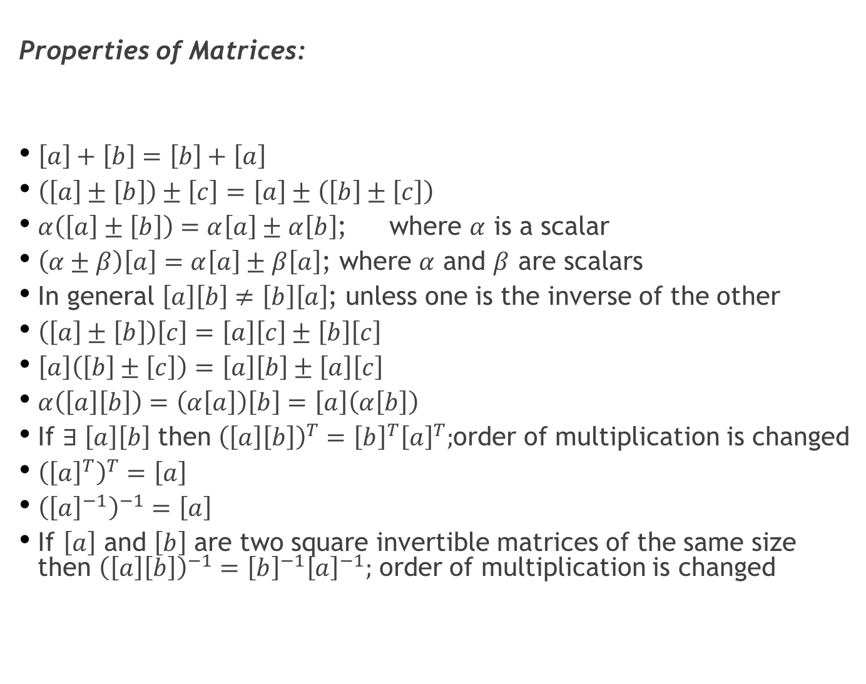
Properties of Matrices:
$\left[a\right]+\left[b\right]=\left[b\right]+\left[a\right]$
$\left(\left[a\right]±\left[b\right]\right)±\left[c\right]=\left[a\right]±\left(\left[b\right]±\left[c\right]\right)$
$α\left(\left[a\right]±\left[b\right]\right)=α\left[a\right]±α\left[b\right]$; where $α$ is a scalar
$\left(α±β\right)\left[a\right]=α\left[a\right]±β\left[a\right]$; where $α$ and $β$ are scalars
In general $\left[a\right]\left[b\right]≠\left[b\right]\left[a\right]$; unless one is the inverse of the other
$\left(\left[a\right]±\left[b\right]\right)\left[c\right]=\left[a\right]\left[c\right]±\left[b\right]\left[c\right]$
$\left[a\right]\left(\left[b\right]±\left[c\right]\right)=\left[a\right]\left[b\right]±\left[a\right]\left[c\right]$
$α\left(\left[a\right]\left[b\right]\right)=\left(α\left[a\right]\right)\left[b\right]=\left[a\right]\left(α\left[b\right]\right)$
If $∃ \left[a\right]\left[b\right]$ then ${\left(\left[a\right]\left[b\right]\right)}^{T}={\left[b\right]}^{T}{\left[a\right]}^{T};$order of multiplication is changed
${\left({\left[a\right]}^{T}\right)}^{T}=\left[a\right]$
${\left({\left[a\right]}^{−1}\right)}^{−1}=\left[a\right]$
If $\left[a\right]$ and $\left[b\right]$ are two square invertible matrices of the same size then ${\left(\left[a\right]\left[b\right]\right)}^{−1}={\left[b\right]}^{−1}{\left[a\right]}^{−1};$ order of multiplication is changed

Slide 42

The Determinant of a Matrix:
Useful quantity that is used to determine if a matrix has an inverse.
over all $n!$

Slide 43



Cramer’s Rule and Solution to a System of Simultaneous Equations:
Given a set of $n$ simultaneous equations with $n$ unknowns:
The system of equations can be written compactly using matrices (indeed this is the primary use of matrices!):
i.e.

Slide 44


Cramer’s Rule and Solution to a System of Simultaneous Equations:
Cramer’s Rule states that the solution (for $\left[x\right]$), if it exists, is given by:
where $a_{j}^{′}$ is the matrix formed by replacing the $j$th column of the matrix $\left[a\right]$ with the column vector $\left[b\right].$
Note: ${\left[a\right]}^{−1}$ exists $iff det⁡(a)≠0$
$\det\left(a\right)=0$ if one or more columns or rows of $\left[a\right]$ are not linearly independent.

Slide 45


Example:

Slide 46

Ordinary Differential Equations (ODE):
An ordinary differential equation is one that contains one dependent variable (e.g. y), one independent variable (e.g. x) and ordinary (as opposed to partial) derivatives of the dependent variable.
It is said to be linear if its dependence on the dependent variable and its derivatives is linear.
Examples of linear ODEs:
$$\frac{dy}{dx}=10x$$
$$c\frac{dx}{dt}+kx=−m\frac{d^{2}x}{dt^{2}}$$

Slide 47

Ordinary Differential Equations (ODE):
An ODE is non-linear if any of the coefficients are functions of the dependent variable.
Examples:
$$\frac{d^{2}y}{dt^{2}}+\sin{y}=4$$
$$y\frac{d^{2}y}{dt^{2}}+3y=8$$

Slide 48

Ordinary Differential Equations (ODE):
An ODE is said to be homogeneous if the coefficient of the independent variables is zero. Otherwise it is said to be nonhomogeneous.
Examples:
$$\frac{dy}{dx}=10x$$
Is a linear, nonhomogeneous ODE.
$$\frac{d^{2}y}{dt^{2}}+\sin{y}=4$$
Is a non-linear, homogeneous ODE.

Slide 49

Ordinary Differential Equations (ODE):
The order of an ODE is the highest derivative that appears in the equation.
Example:
$$\frac{d^{2}y}{dt^{2}}+\sin{y}=4$$
Is a second order ODE.

Slide 50

Ordinary Differential Equations (ODE):
Boundary Conditions/Initial Conditions:
To eliminate integration constants when solving a DE we apply constraints. These are referred to as boundary conditions (solutions to the DE at particular points) and in the case of time dependent DEs, initial conditions (or the solution to the DE at $t=0$).

Slide 51


Solution to Non-Homogeneous Linear First Order ODE:
Consider:
Multiply both sides of this equation by the following integrating factor:
This gives (do it as an exercise!):

Slide 52


Solution to a Non-Homogeneous Linear First-Order ODE:
Integrating both sides gives:
Dividing through by $μ\left(x\right)$ gives:
The constant of integration is determined from a constraint which is problem dependent.

Slide 53


Solution to an Homogeneous Linear Second-Order ODE:
Consider:
where $a$ and $b$ are constants.
The general solution to this equation is found by substituting $y=e^{sx}$. The resulting equation is called the characteristic equation:

Slide 54




Solution to an Homogeneous Linear Second-Order ODE:
The solution is obtained from the quadratic formula:
The general solution is then:
If $b^{2}<4ac$ we get:

Slide 55

Functions of Two or More Independent Variables:
Consider the function:
$$z=f\left(x,y\right)=\frac{x^{2}}{4}+\frac{y^{2}}{9}$$
This is a function of two variables where $z$ is the dependent variable and $x$ and $y$ are the independent variables.

Slide 56


The Partial Derivative:
For $z=f(x,y)$, the first partial derivative of $f$ with respect to $x$ is denoted by $\frac{δf}{δx}$ or $f_{x}$ and is defined by:
if the limit exists. Also:

Slide 57

The Partial Derivative:
The partial derivative with respect to a certain variable (say $x$) simply by treating (or ‘holding’) all other independent variables (say $y$ and $z$) as constants.
Imagine you have an x and y axis on your desk. At the origin you now place an axis, z, perpendicular to the x and y axes.
Now you can plot functions of two variables i.e. z=f(x,y). This will give you a three-dimensional surface.
It does not make sense to attempt to get $\frac{dz}{dx}$ since this depends on y. We instead get the partial derivative $\frac{∂z}{∂x}$. That is we perform the differentiation of z wrt x while holding or treating y as a constant i.e. we perform the differentiation wrt x on an x-z plane given by the value of y, for example y=4. If we choose y=0 then $\frac{∂z}{∂x}$= $\frac{dz}{dx}$.
Partial differentiation wrt a particular variable is then performed by treating the other variables as constants. The result may or may not be a function of those other variables. In other words the surface may or may not vary wrt that variable.

Slide 58

The Partial Derivative:
Some examples should make the topic clear:
Example 1: ${f\left(x,y\right)=x}^{2}+2xy+3$
$\frac{∂f(x,y)}{∂x}=2x+2y$
and $\frac{∂f(x,y)}{∂y}=2x$
Example 2: $f\left(x,y\right)=e^{yx}$
$\frac{∂f(x,y)}{∂x}=ye^{yx}$
Example 3: $f\left(x,y\right)=ay\sin{ax}$ $a∈R$
$\frac{∂f(x,y)}{∂x}=ay\cos{ax}$

Slide 59


The Partial Derivative:
The partial derivative with respect to a certain variable (say $x$) simply by treating (or ‘holding’) all other independent variables (say $y$ and $z$) as constants.
The total differential (or exact differential) of a function of two variables, say $f\left(x,y\right)$, is given by:

Slide 60


The Partial Derivative:
Using the formula for the total differential we can state:
where $x$ and $y$ are both functions of the independent variable $t$

Slide 61




The Partial Derivative:
Consider $f(x,y)$ where $y=g(x)$ then:
Consider $f(x,y,z)$ where $z=h\left(x,y\right)$ then:
or

Slide 62



The Jacobian:
The Jacobian is a quantity that arises when solving systems of non-linear equations. Given $f_{1}\left(x,y\right)=a$ and $f_{2}\left(x,y\right)=b$ (where $a$ and $b$ are constants) then the Jacobian matrix is:
The Jacobian determinant or simply the Jacobian is:

Slide 63

The Jacobian:
In general the Jacobian is:
More about Jacobians later in the course!

Slide 64


Taylor Series Expansion of Functions:
It is used to represent a function as an infinite power series. This can be useful when trying to integrate certain non-analytic functions since a truncated series may result in a good analytic approximation to the function.
It may also be used in approximating functions to make them more easily manipulated for certain purposes such as increasing computational speed.
Given a function $f(x)$ that is differentiable $n+1$ times in an interval containing $x=x_{0}$, Taylor’s theorem states that
$∃ ξ ∈\left[x,x_{0}\right]$ such that:

Slide 65


Taylor Series Expansion of Functions:
Where
Note that $R_{n}$ cannot be calculated since $ξ$ is unknown.
For $n=0$the Taylor Series reduces to:
which is a statement of the Mean Value Theorem.

Slide 66


Example:

Slide 67

Taylor Series for a Function of Two Variables:
Taylor’s expansion for a function of two variables is done the same way as for a function of one independent variable except that the differentiation involves partial derivatives.

Slide 68

Inner Product and Orthogonality:
The inner product (scalar product or ‘dot’ product)of two vectors $\vec{V}$ and $\vec{U}$ is denoted $\left\langle \vec{V}|\vec{U}\right\rangle$ or $\left\langle \vec{V},\vec{U}\right\rangle$ or $\vec{V}∙\vec{U}$.
Say $\vec{V}=V_{x}\hat{i}+V_{y}\hat{j}+V_{z}\hat{k}$ and $\vec{U}=U_{x}\hat{i}+U_{y}\hat{j}+U_{z}\hat{k}$.
Then:
The vectors are said to be orthogonal to each other (or simply orthogonal) if:
$\left\langle \vec{V}|\vec{U}\right\rangle =0$
and parallel if: $\left\langle \vec{V}|\vec{U}\right\rangle =1.$

Slide 69

Inner Product and Orthogonality:
The inner product of two functions $f(x)$ and $g(x)$ over an interval $\left[a,b\right]$ is given by:
$$\left\langle f\left(x\right)|g(x)\right\rangle =\int_{a}^{b}{f\left(x\right)g\left(x\right)dx}$$
Again, they are said to be orthogonal if:
$\left\langle f\left(x\right)|g(x)\right\rangle =0$
Importantly the sine and cosine functions are orthogonal at all frequencies. That is:

Slide 70
Recommended Problems:
Problems to be solved by hand (do at least 2): 2.2, 2.8, 2.22
Problems to be programmed in Matlab (do at least 1): 2.27, 2.31
Problems in math, science and engineering (do at least 1):
2.32, 2.34, 2.36
You should pick out problems that you find interesting/challenging and do these too. Use SI units (without conversion).

